Slide 1

IBM CLOUD
Managed Redhat Openshift
by IBM Cloud on Azure using IBM Satellite
Vann Lam
Last update: 2022-05
© 2022 IBM Corporation
Notes:
Author: Lionel Mace – lionel.mace@fr.ibm.com

Slide 2
Introduction
In this document, we will be provisioning a ROKS cluster in an IBM Cloud satellite location hosted in an Azure account.
We will be using an IBM Cloud account, a Microsoft Azure account.
On Azure account, we will be provisioning VMs, for ….

Slide 3
Prereq on getting started on ROKS on Azure with IBM Cloud Satellite
You need to have an IBM Cloud account
You need to have a Microsoft Azure account
(Azure Client ID, Azure tenant ID and Azure secret key) are sufficient

Slide 4
Steps to get started on ROKS on Azure with IBM Cloud Satellite
Create an IBM Cloud location on Azure
Deploy ROKS on the location
Create an image registry in ROKS to the COS bucket
Deploy Portworx on ROKS
Deploy ODF on ROKS

Slide 5
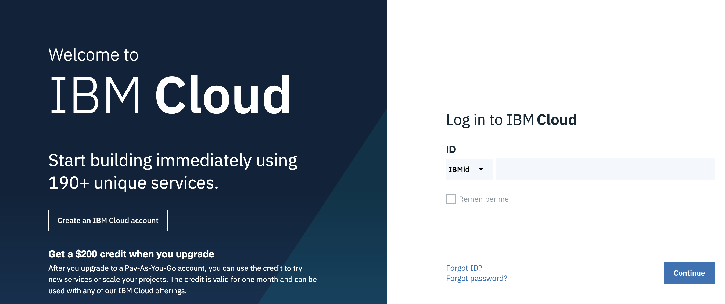
Log in to IBM Cloud with IBMid on a web browser
http://cloud.ibm.com

Slide 6
Log in to IBM Cloud with CLI
IBM Cloud CLI installation :
https://cloud.ibm.com/docs/cli?topic=cli-install-ibmcloud-cli
ibmcloud login
Use your IBMid credentials
ibmcloud login --sso
Use your enterprise credentials
Log in to Microsoft Azure with CLI
az login --service-principal
-u < Azure Client ID >
-p < Azure key >
--tenant < Azure tenant ID >

Slide 7
1. Create an IBM Cloud location on Azure

Slide 8
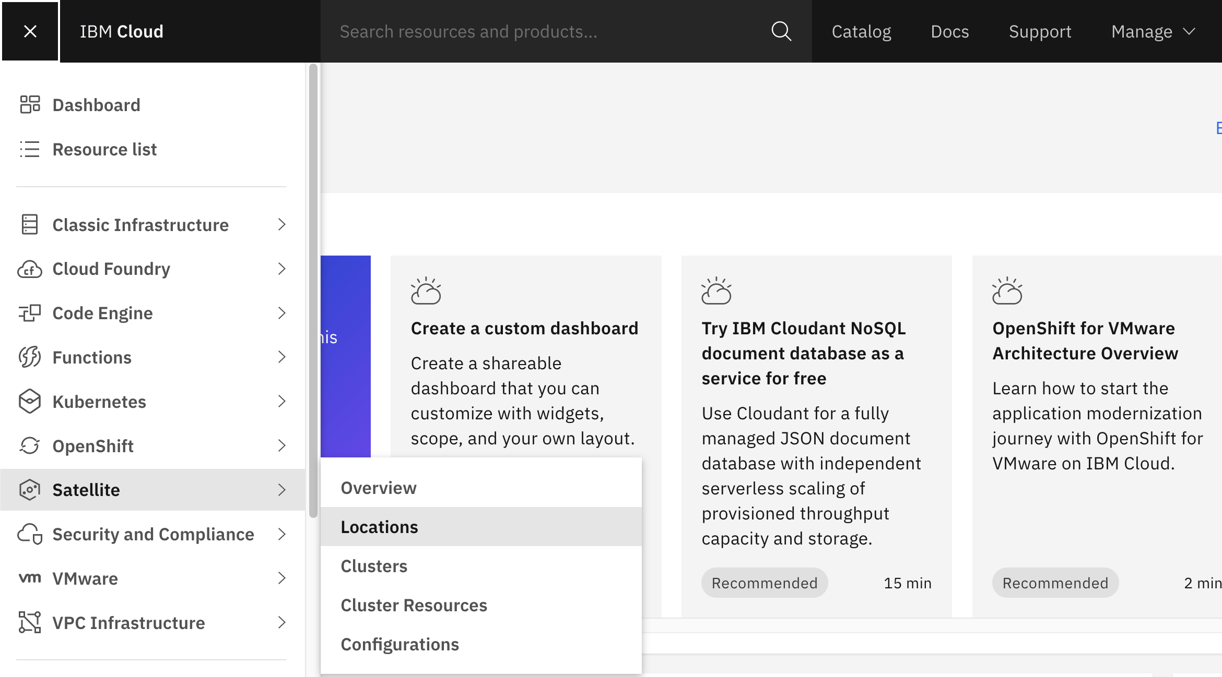
Go to Satellite Locations
1

Slide 9
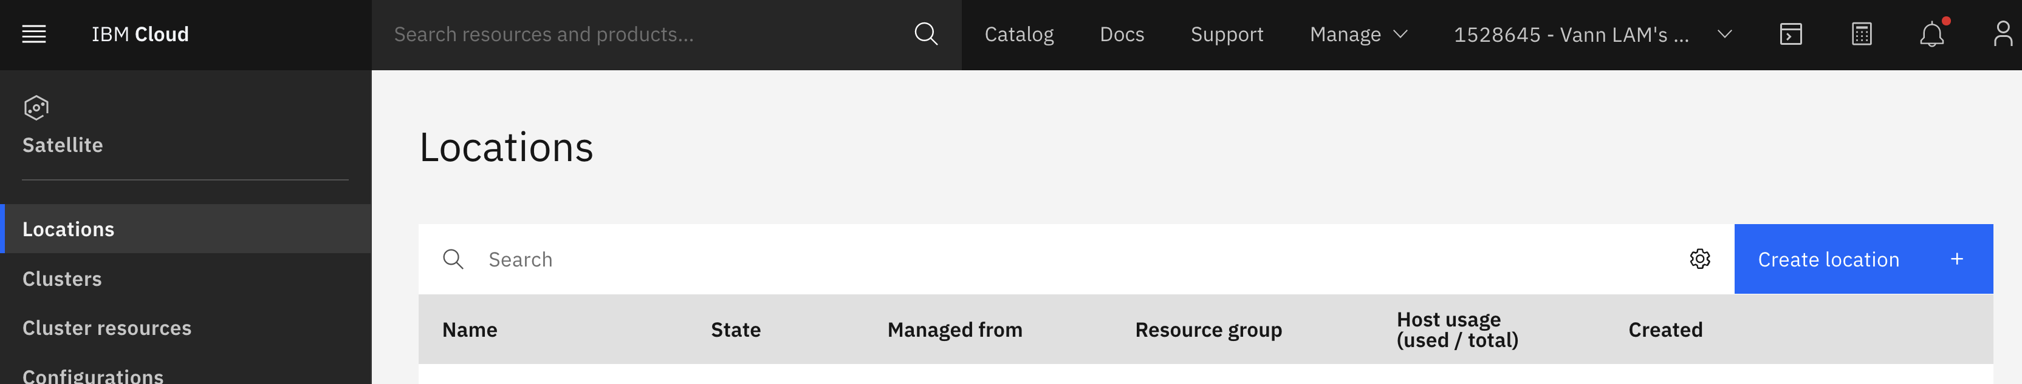
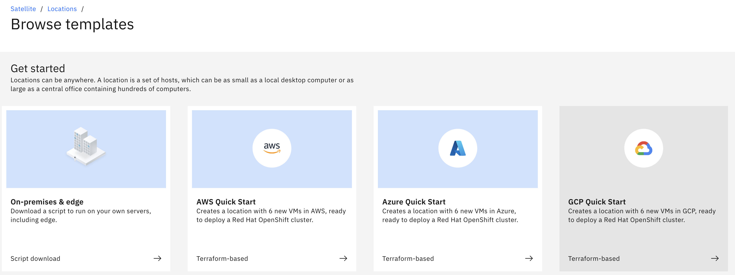
Create location on Azure
1
2

Slide 10
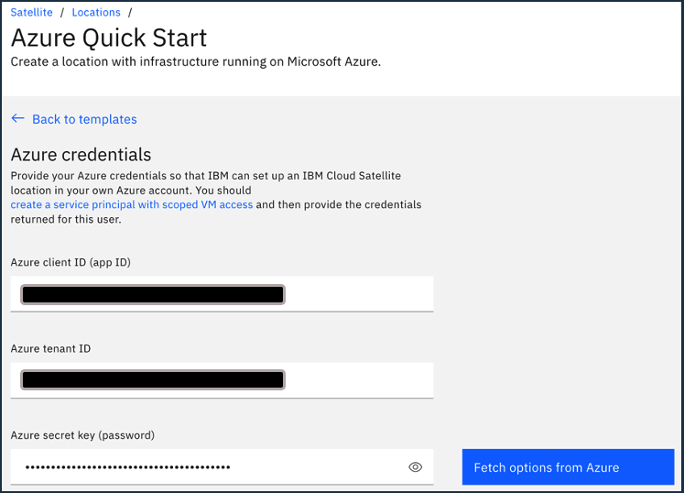
Enter Azure credentials
1
2

Slide 11
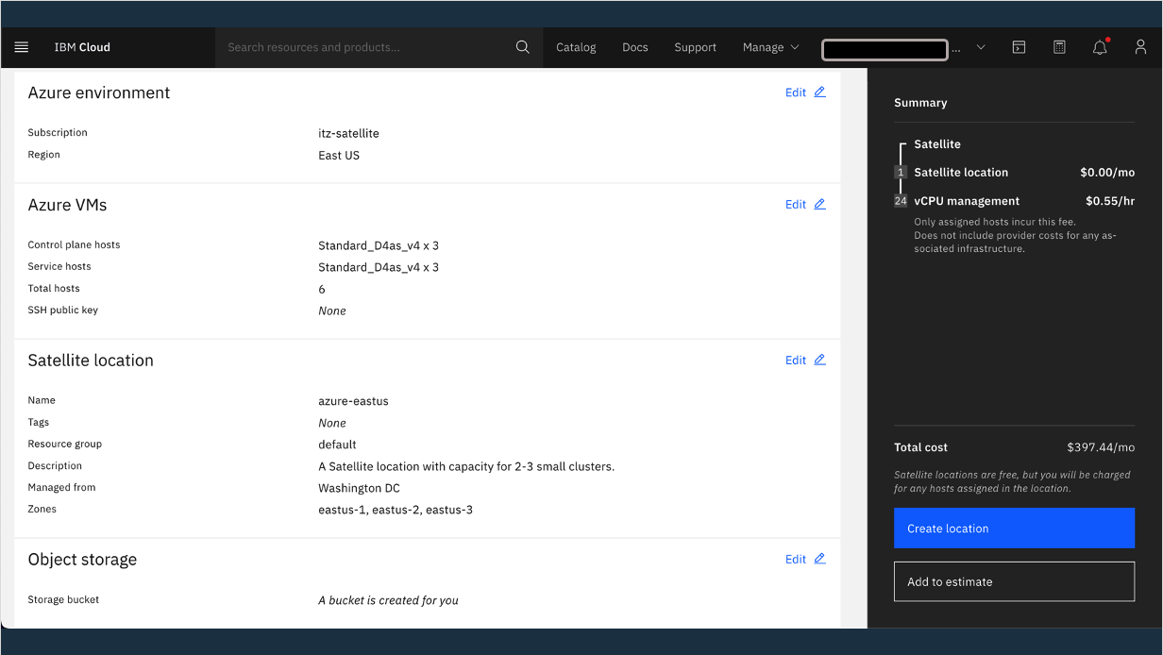
Choose your VMs profile and Satellite location name and “Managed from” site
1
2
3

Slide 12
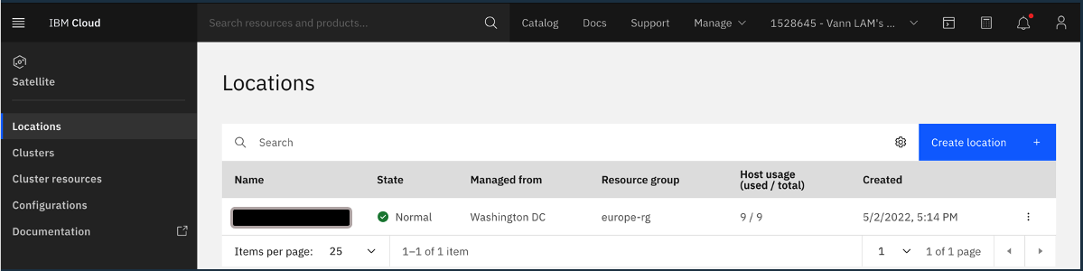
Back to location, location is available within 10 minutes
1

Slide 13
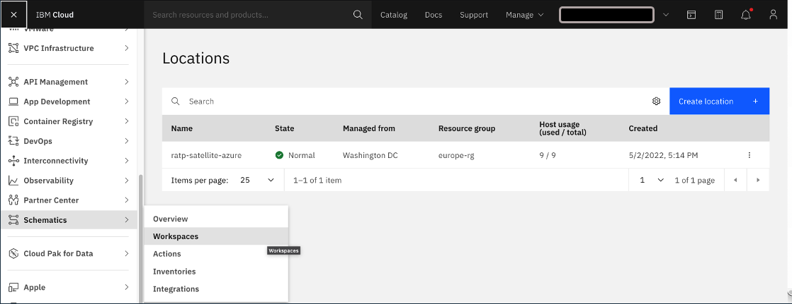
Terraform script within Schematics
1

Slide 14
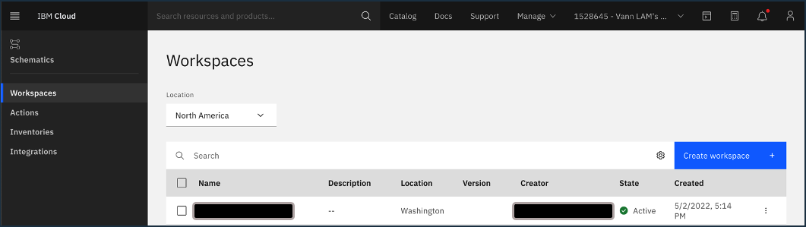
Terraform script within Schematics
1

Slide 15
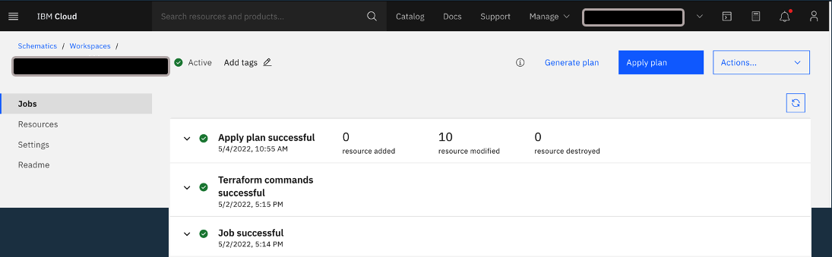
Terraform plan created and executed automatically

Slide 16
2. Deploy ROKS on a location on Azure

Slide 17
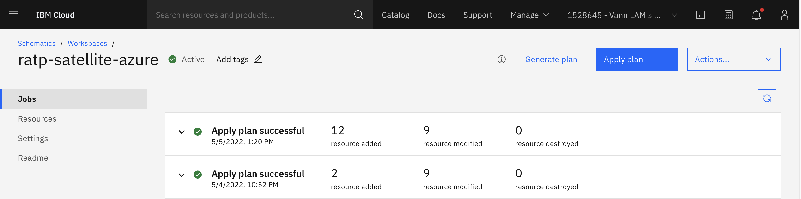
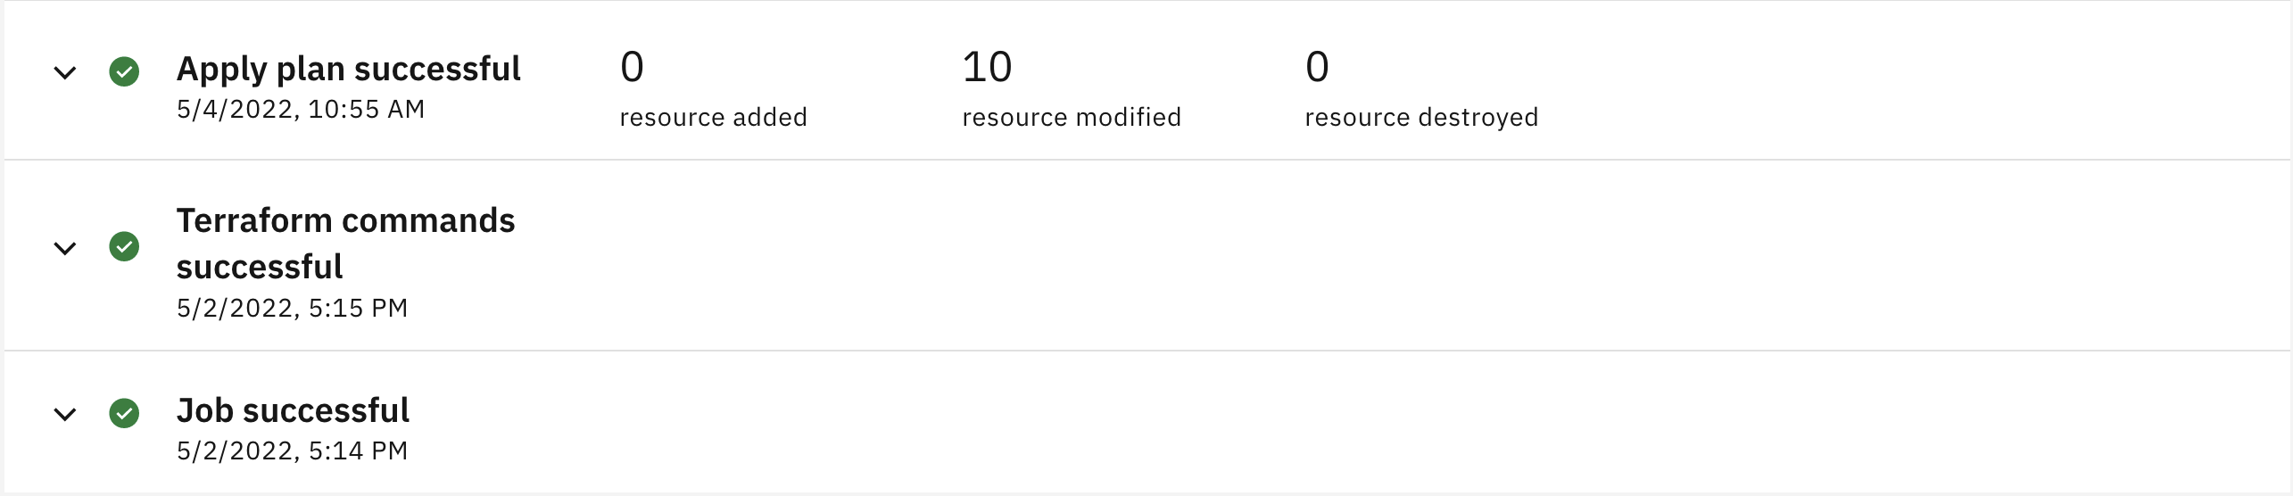

Slide 18
Terraform plan created and executed automatically

Slide 19
3. Manage the Account Structure with Resource Group (RG)

Slide 20
IBM Cloud Governance Model
Account Owner
Enterprise Account
Account Group *
Account Owner
Users & Permissions
Account *
IBM Cloud Sub- Account
Resource Group
Resource isolation
Tag*
Resource Instance
Resource Instance
Service Instances

Slide 21
Resource Groups (RG) are cross regions
Region: Frankfurt
Region: UK
Main Benefits:
Isolation your account resources
Manage Access using IAM
View billing usage per Resource Groups
RG
Non Prod
Service A
Service B
RG
Prod
Service C
Service C
Service C
https://cloud.ibm.com/account/resource-groups
Notes:
This picture shows how you can define multiple spaces in CF that are equivalent (i.e. have parity) and can represent different SDL stages such as Dev and Prod. It also shows how spaces are defined in CF orgs. One org is own by a single developer whereas the other is owned by a group of admins, presumably the ones authorized to deploy apps to Stage and Prod.
Bluemix also has regions. So this shows how spaces are defined in orgs and hosted in regions. The two Prod spaces can be used to implement active/active DR across two different data centers hosted on two different continents (which is way outside the scope of this presentation!).

Slide 22
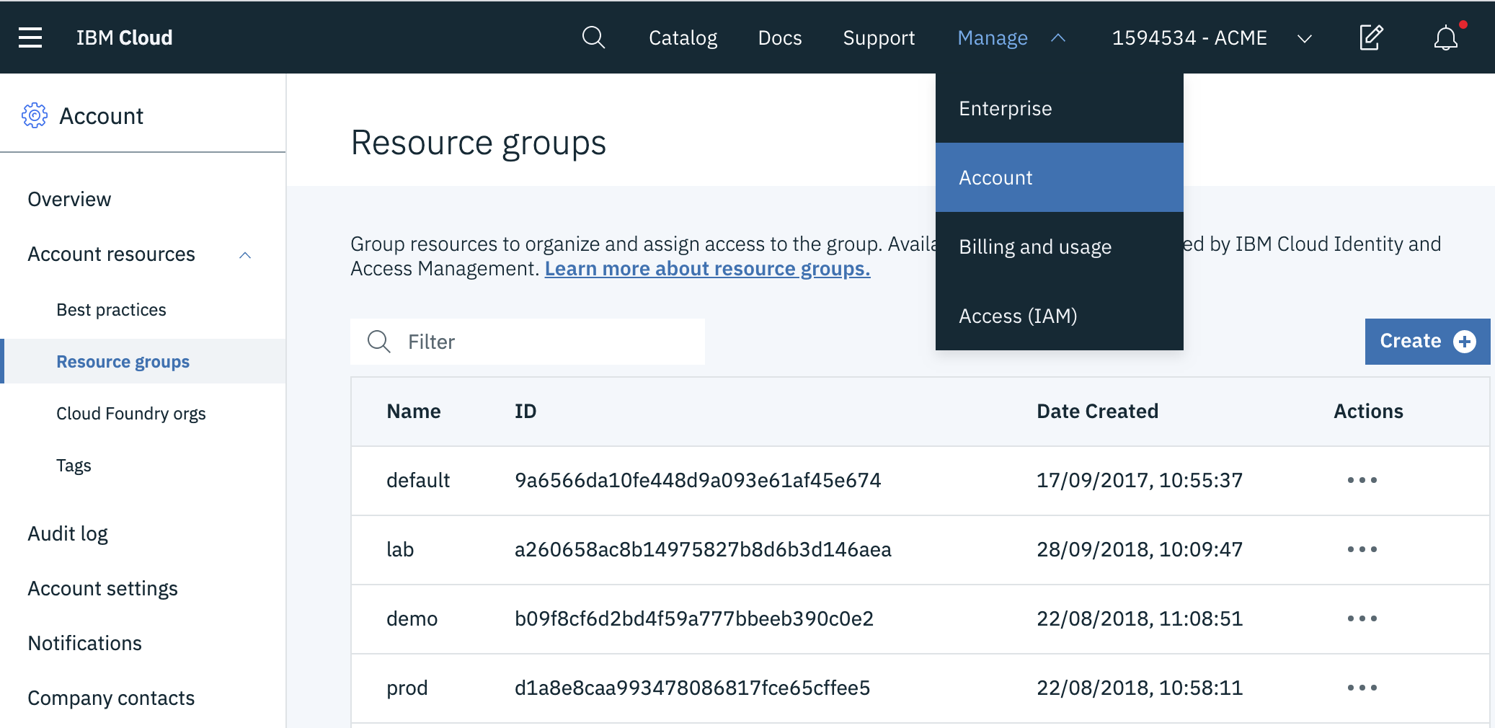
Manage (Create/Delete) Resource Group (RG)
1
3
2

Slide 23
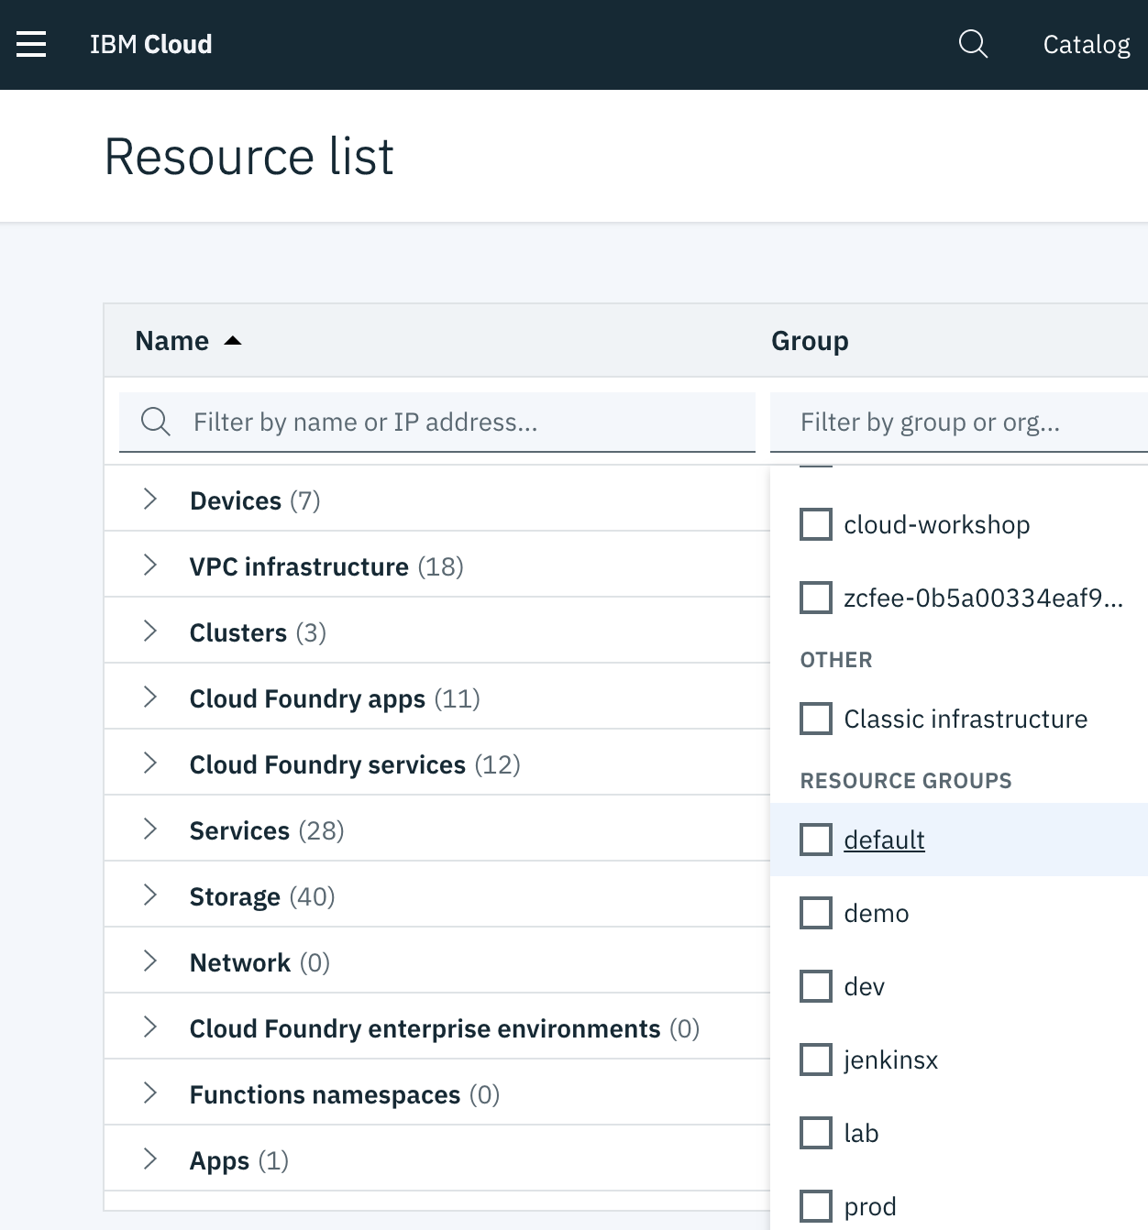
Filter instances per Resource Group
1
2
https://cloud.ibm.com/resources

Slide 24
4. Audit the Account Activities

Slide 25
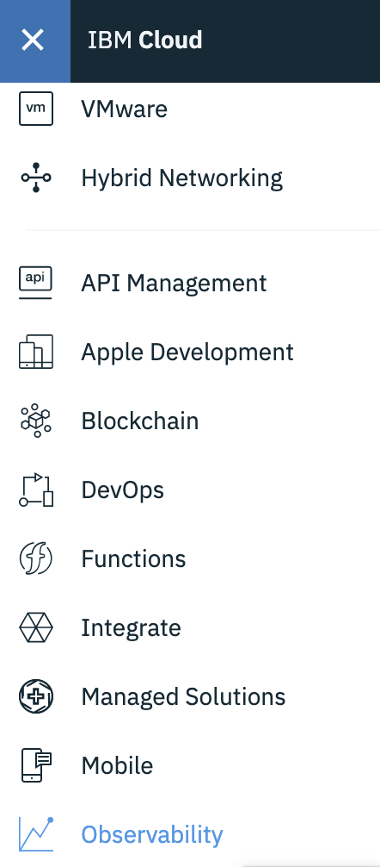
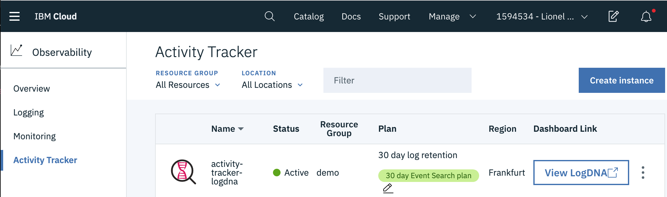
Track all the activities in the account before onboarding users
Create an instance of the service Activity Tracker
3
2
1
https://cloud.ibm.com/observe/activitytracker

Slide 26

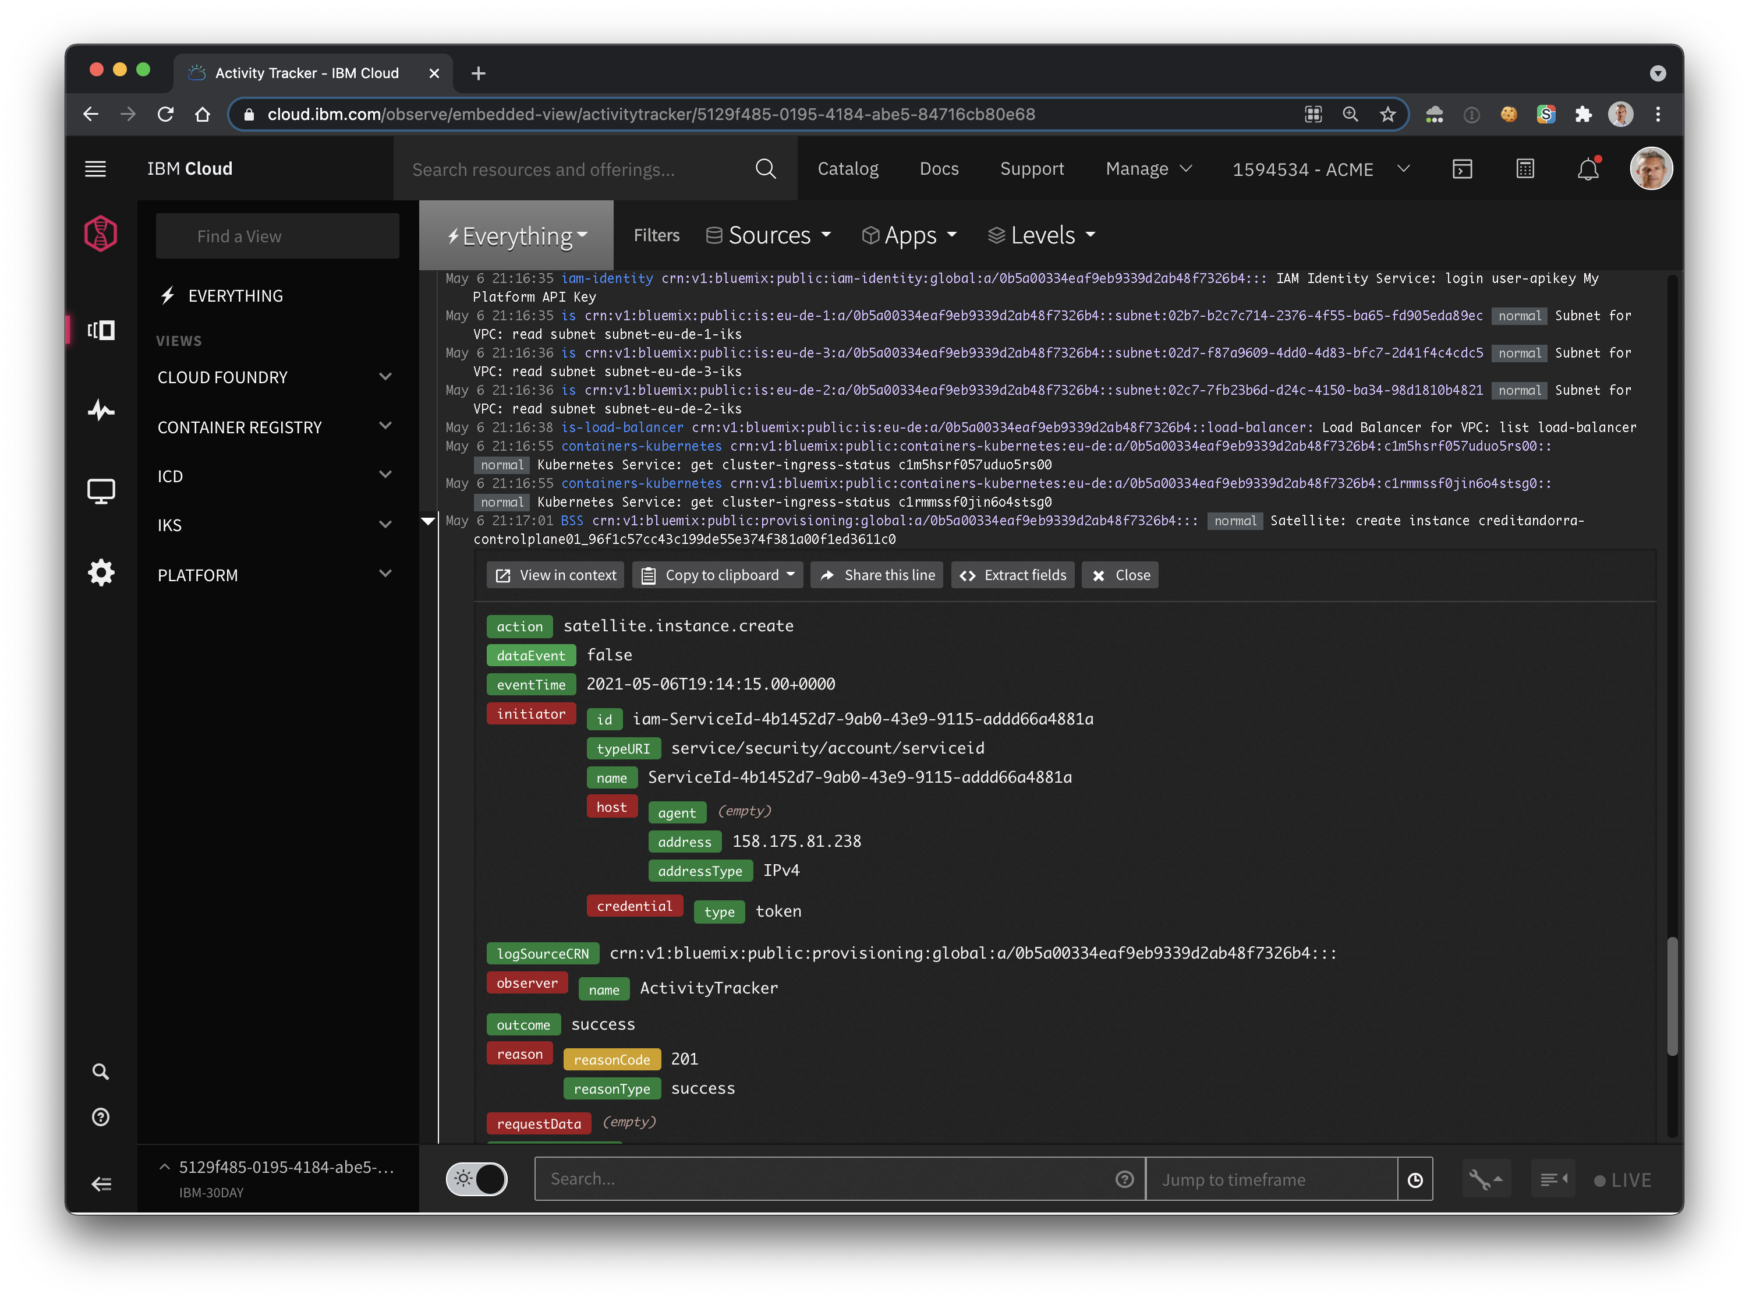
Audit you account activities with Activity Tracker
Audit the activity of
your IBM Cloud account such as new Resources Creation.
Investigate abnormal activity and critical actions.
Be alerted on actions as they happen.
Comply with Cloud Auditing Data Federation (CADF) standard
Retain your events for 7, 14, or 30 days
https://cloud.ibm.com/observe/activitytracker
Notes:
who did what? When?

Slide 27
5. Invite New Users

Slide 28
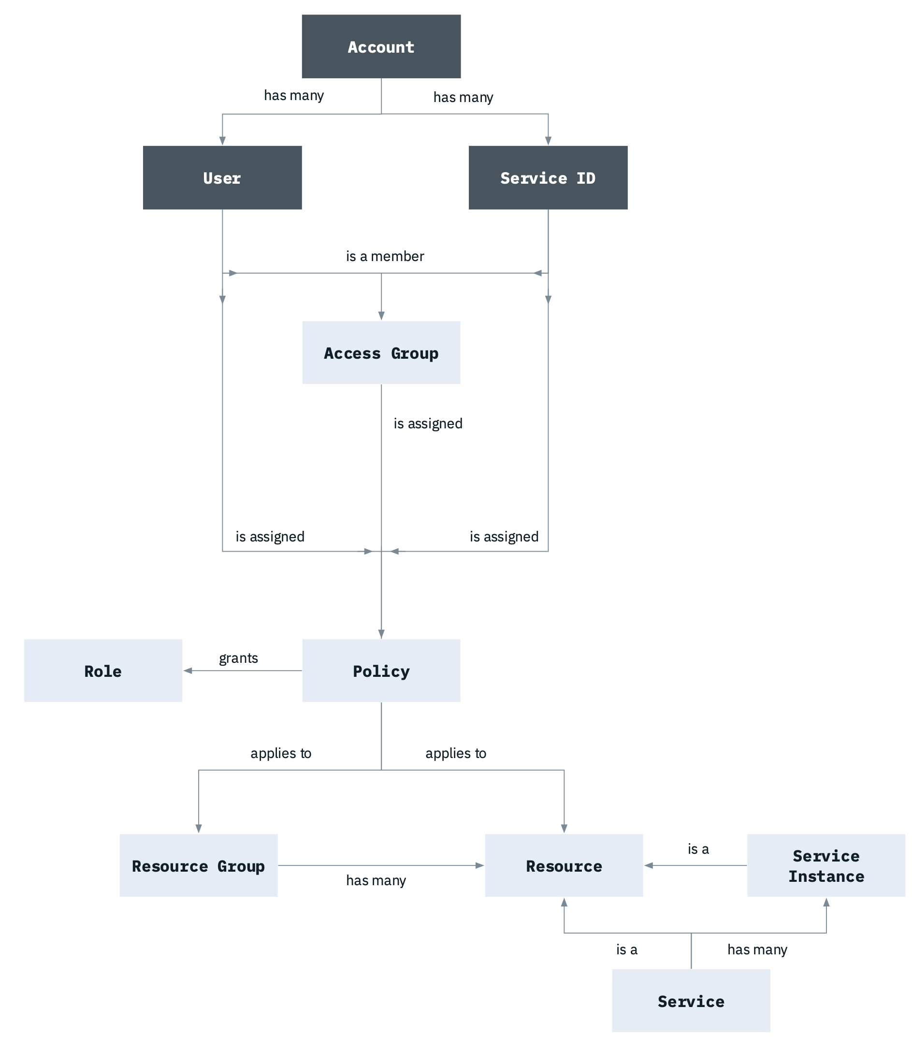
IAM – Identification Access Manager
Enable to securely authenticate users for platform services and control access to resources consistently across IBM Cloud
User management
Fine-grained access control
Access groups for streamlined access
API keys for user authentication
Service IDs
Multifactor authentication
Service to service authorizations
https://cloud.ibm.com/docs/account?topic=account-iamoverview

Slide 29
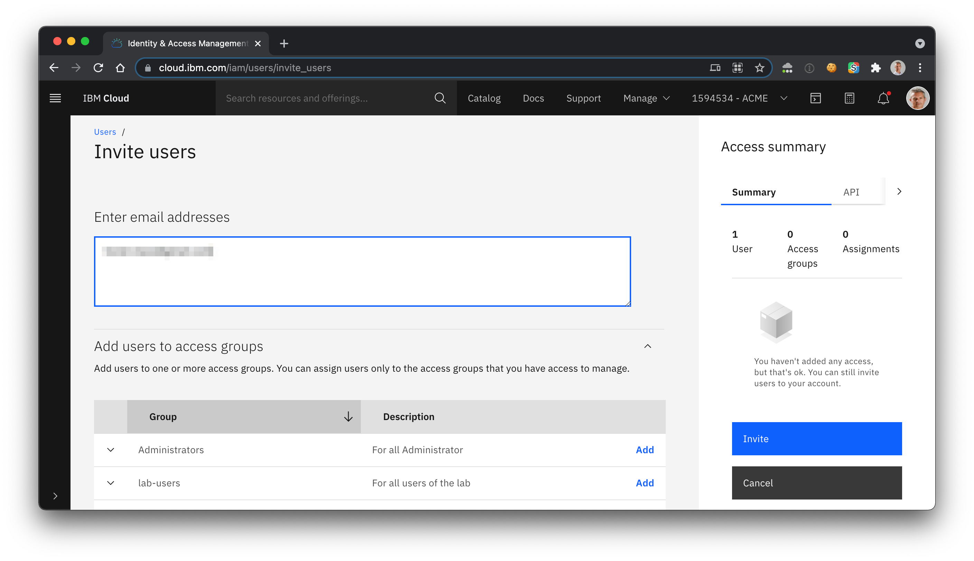
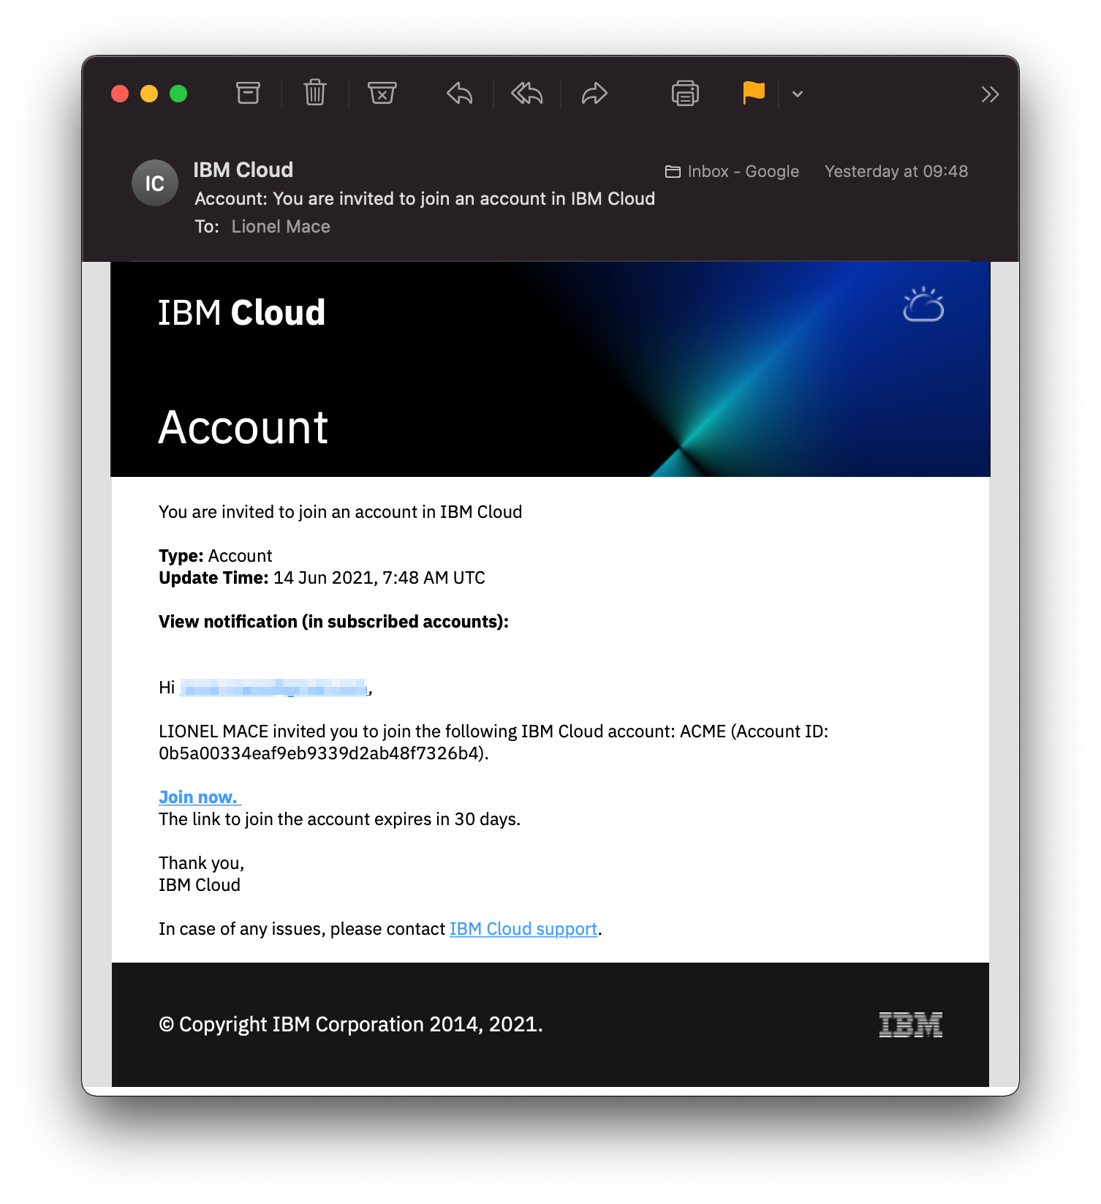
Invited users must accept invitations to each invited account
1
2
3
https://cloud.ibm.com/iam/users/invite_users

Slide 30
6. Control the Cloud Services Consumption

Slide 31
Provisioning scenario: Pulling it all together
Notes:
Diagram Source: https://cloud.ibm.com/docs/third-party?topic=third-party-how-it-works

Slide 32
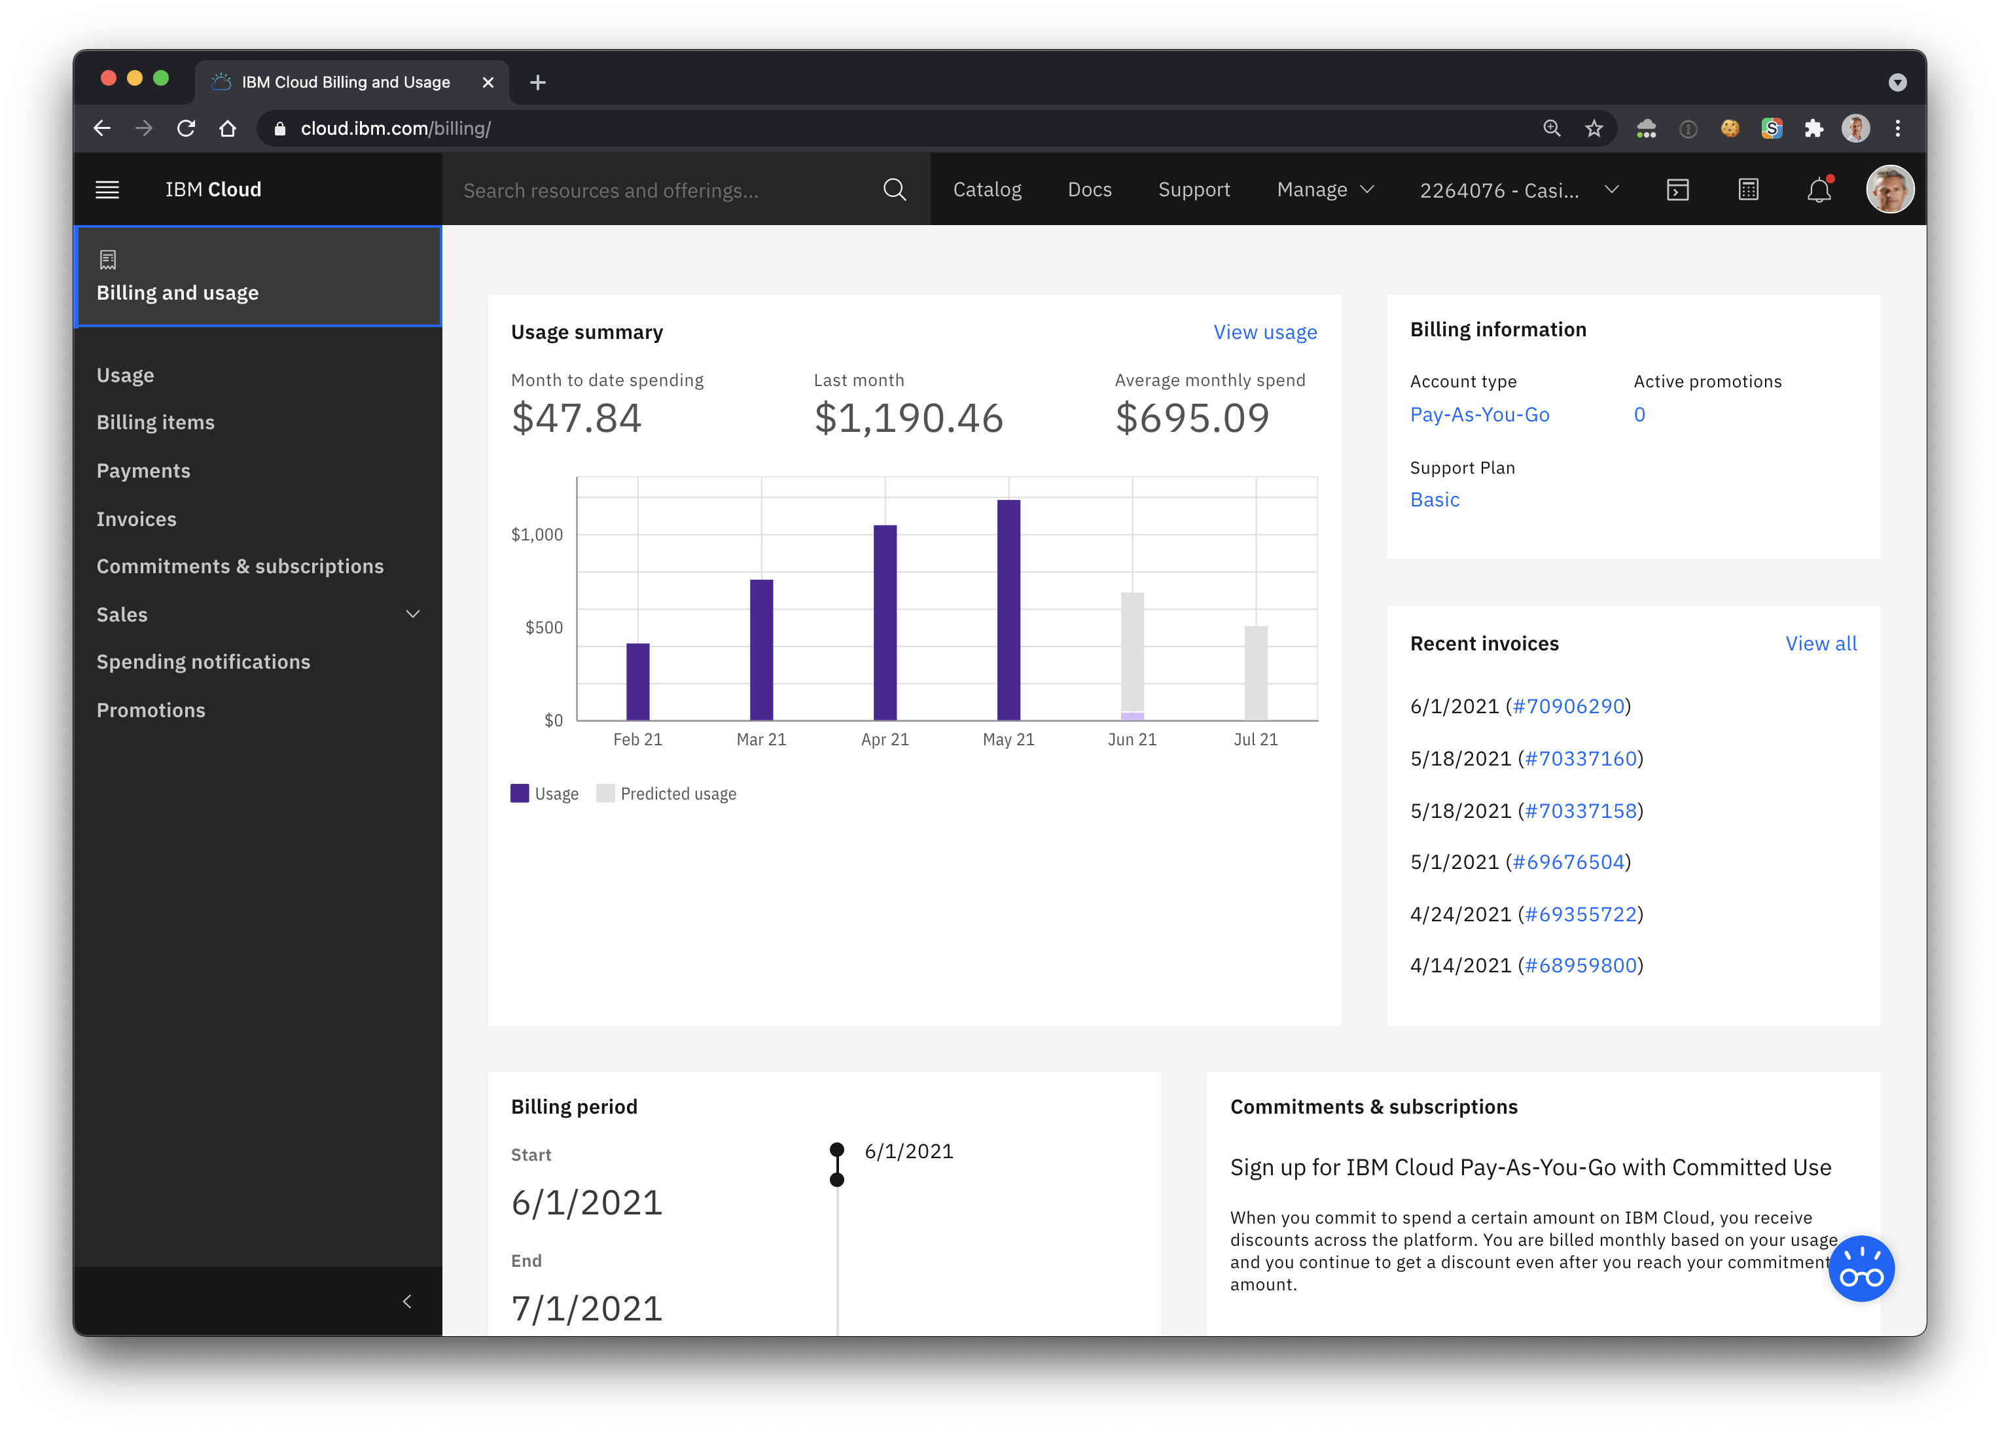
Billing and Usage
https://cloud.ibm.com/billing/

Slide 33
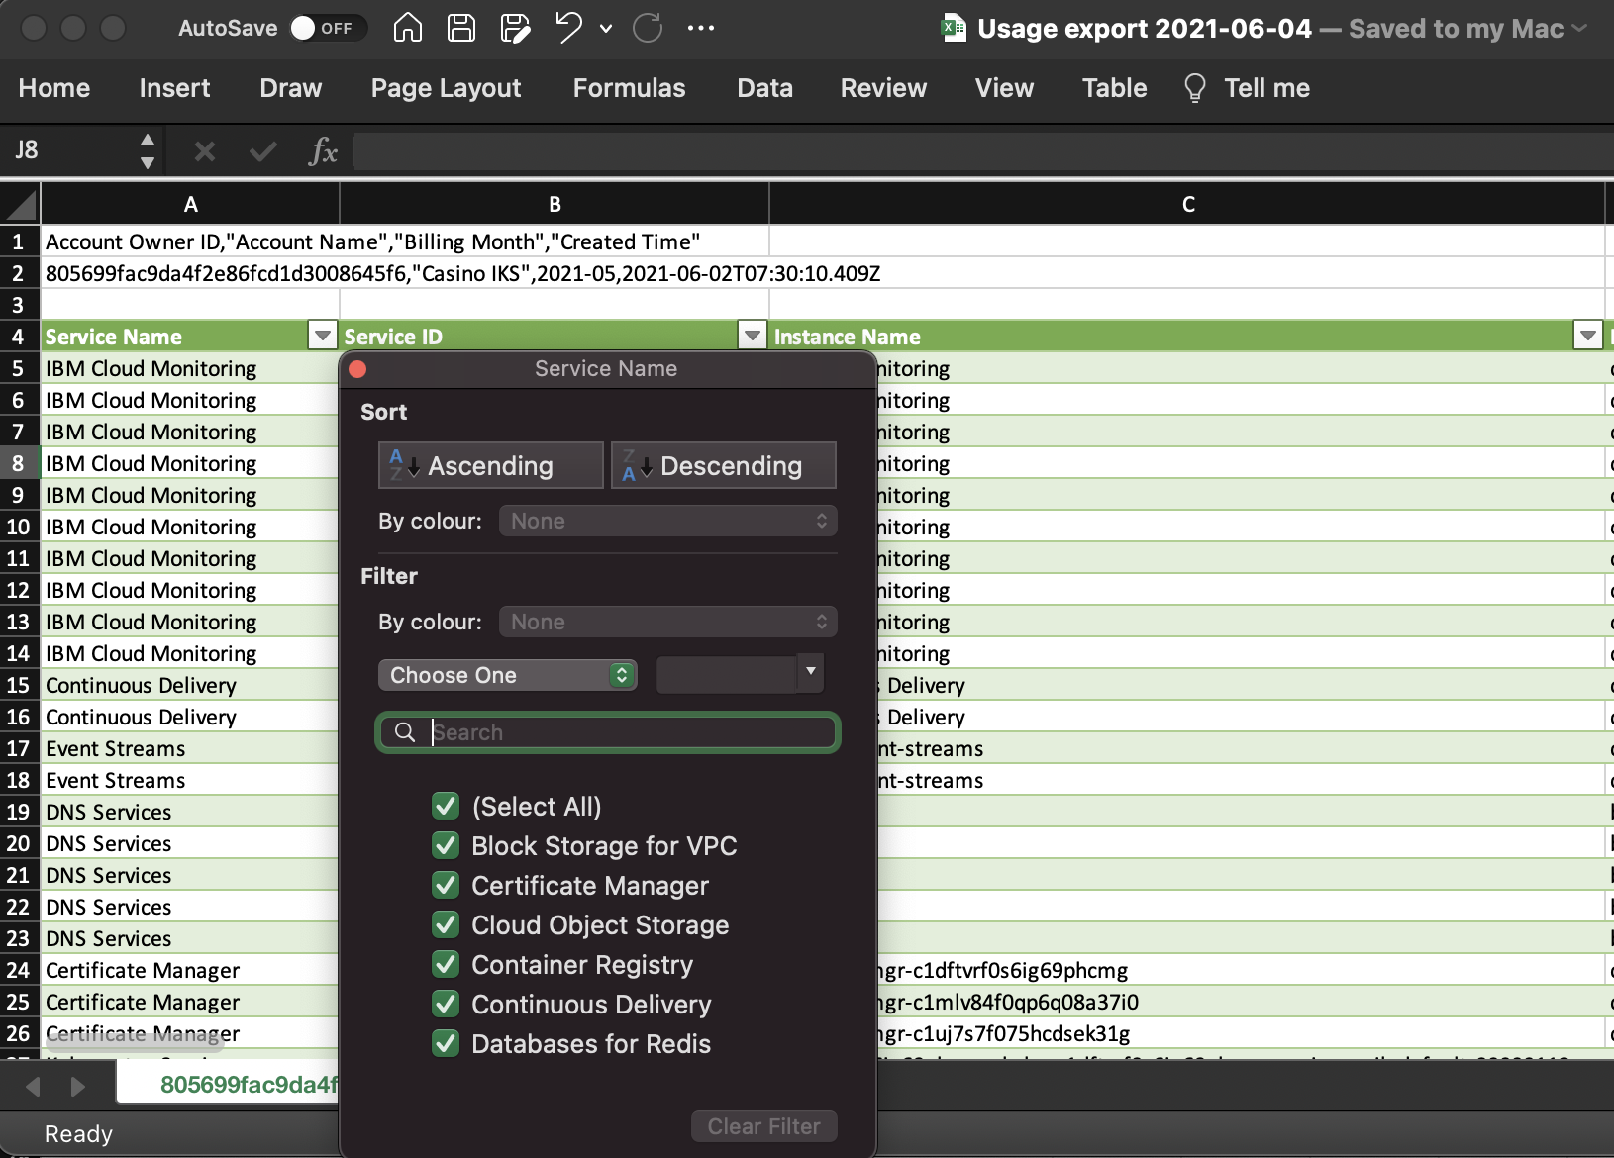
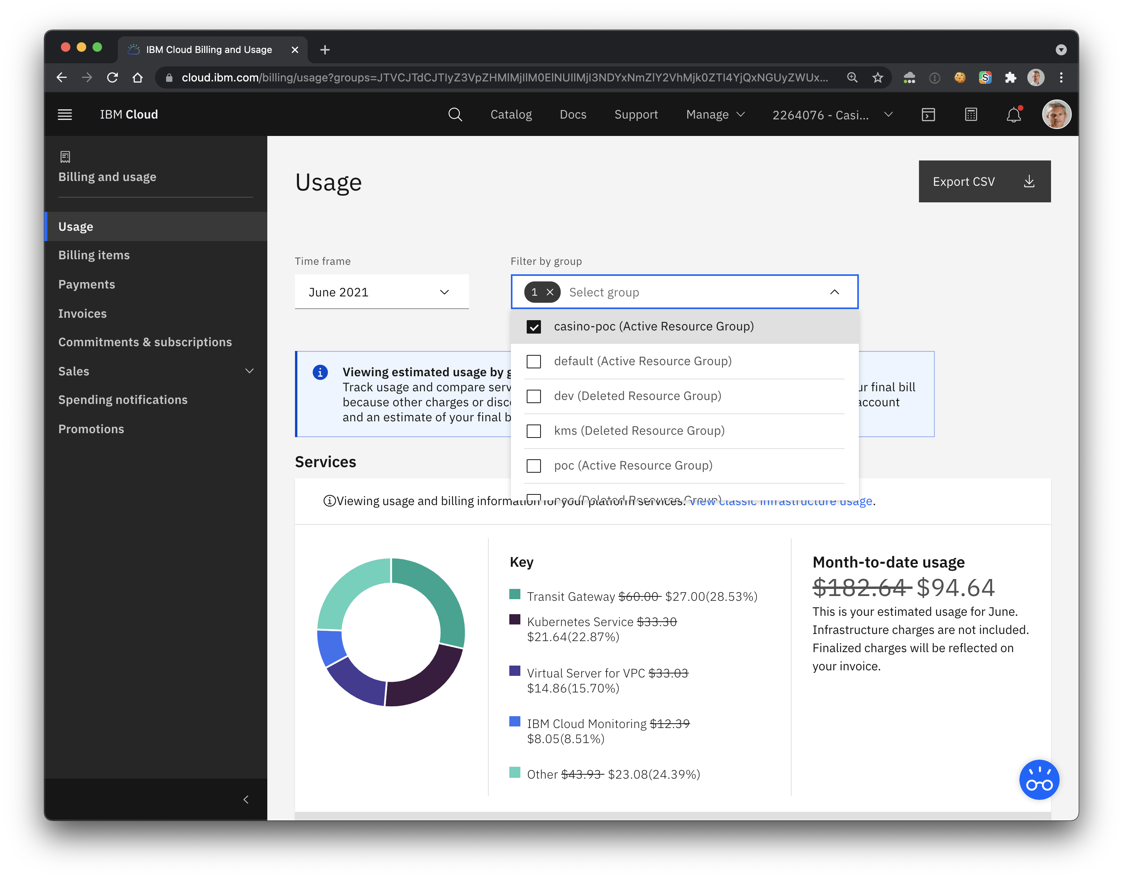
Usage Dashboard and Export
Filter per
Account
Resource Group
Export CSV
Global
Instances
https://cloud.ibm.com/billing/

Slide 34
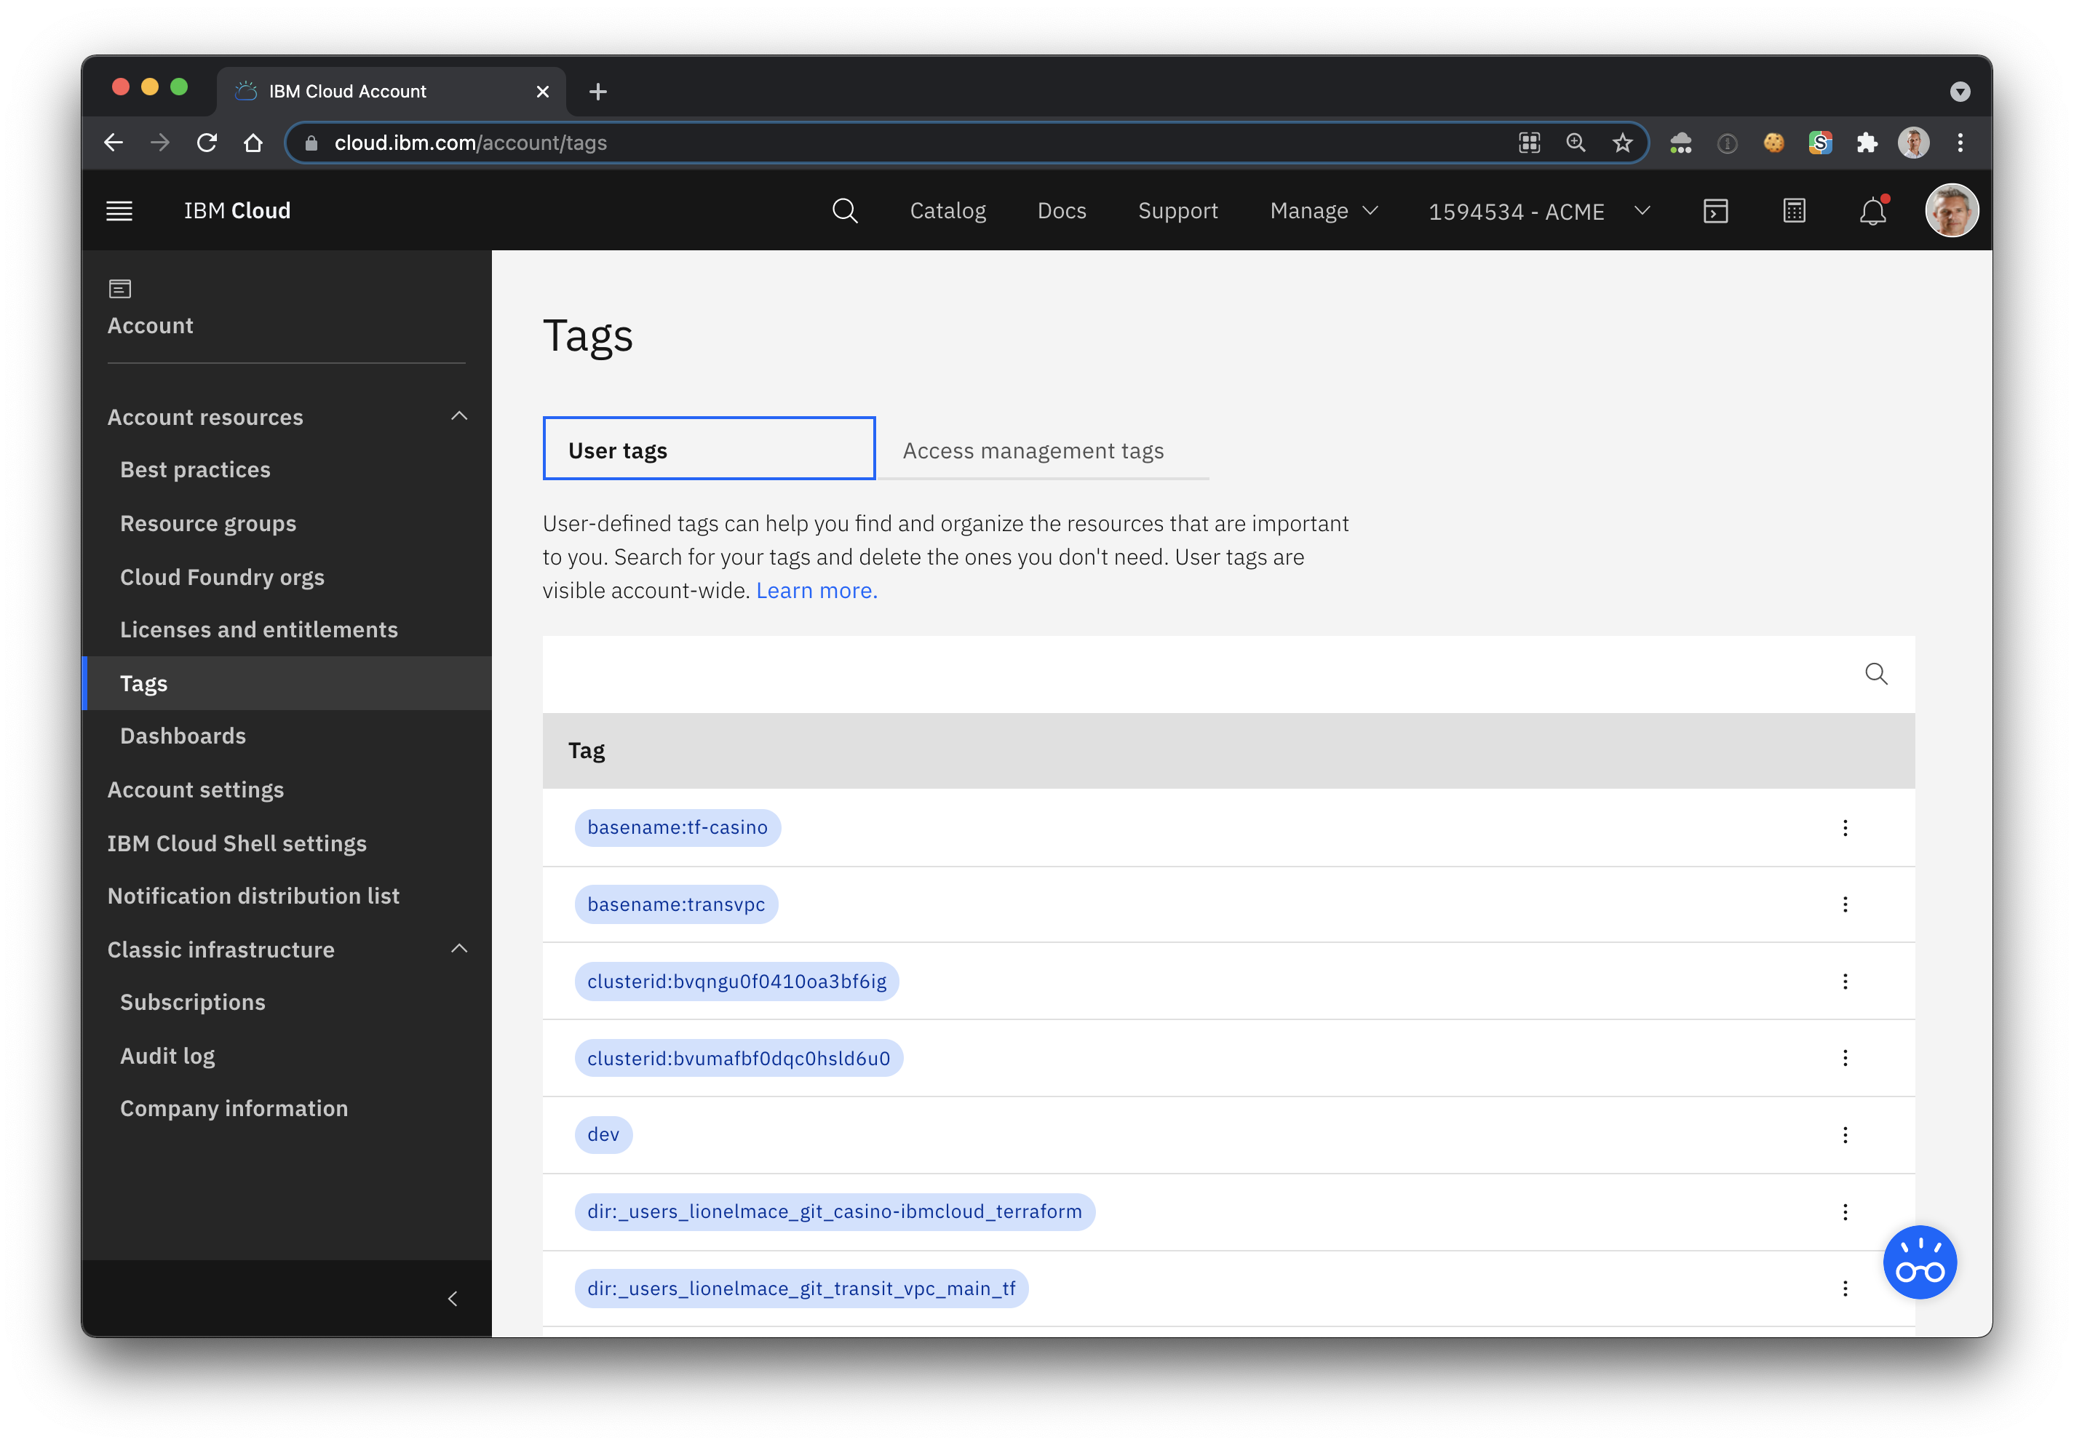
Tag Management

Slide 35
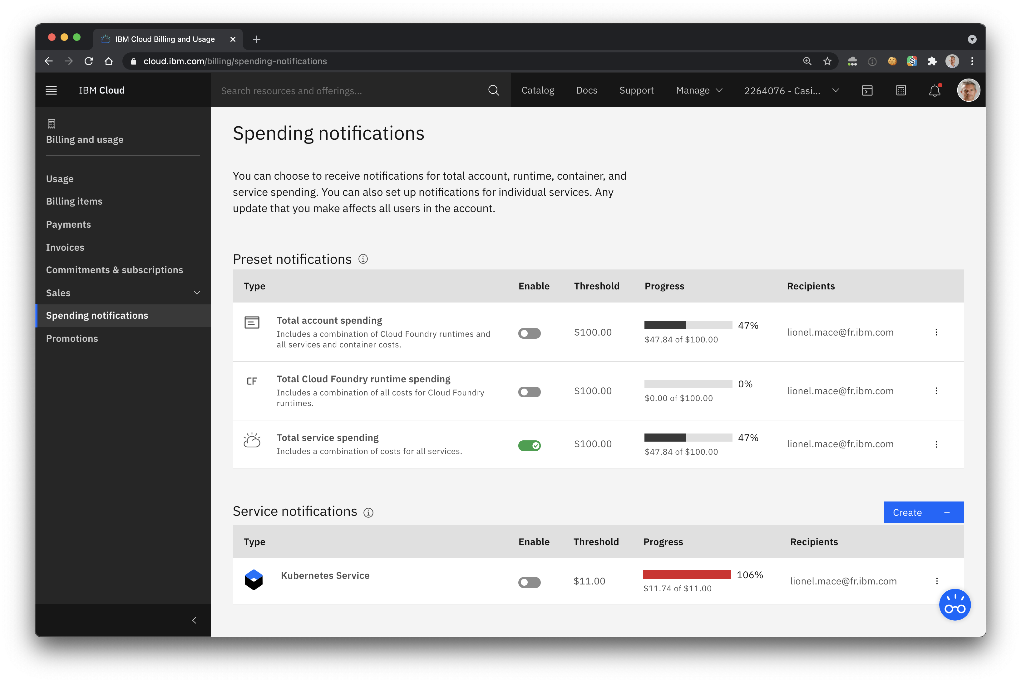
Set Spending Notifications to get email alerts
Alert per Total account
Alert per service
1
2

Slide 36
7. Track Platform Announcements and Status

Slide 37
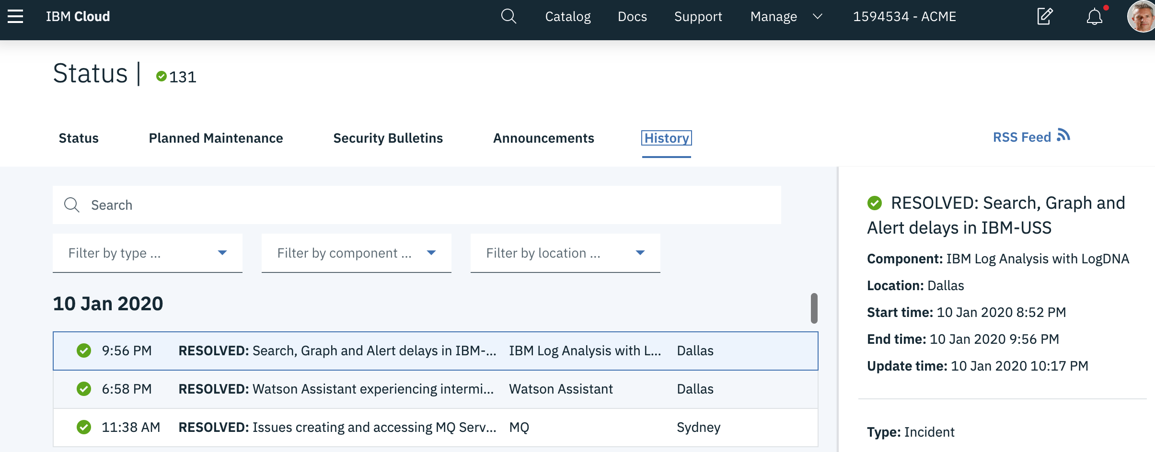
Planned Maintenance, Security Bulletins, Status
https://cloud.ibm.com/status?selected=status

Slide 38
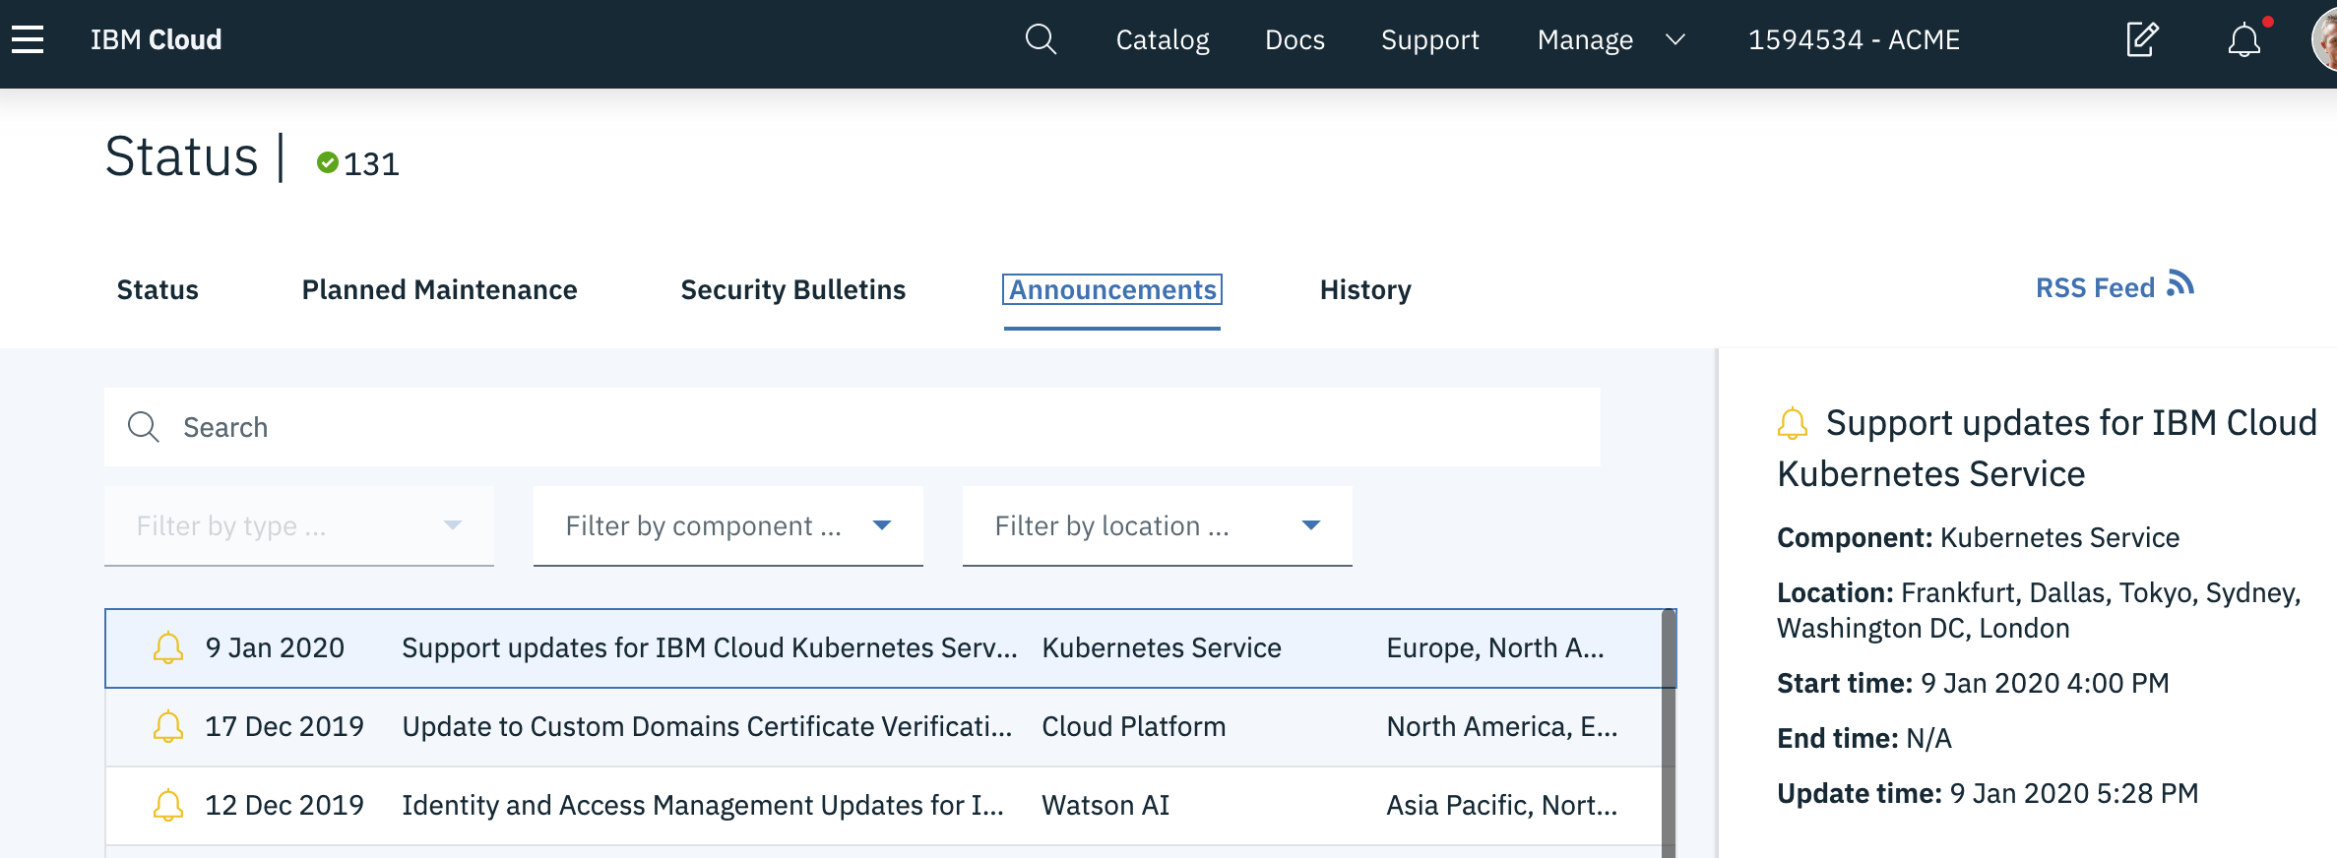
Keep track of Announcements
https://www.ibm.com/cloud/blog/announcements

Slide 39
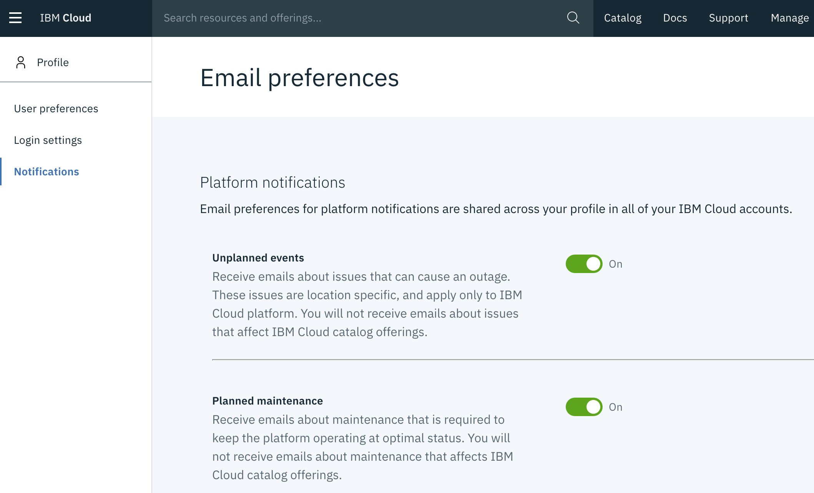
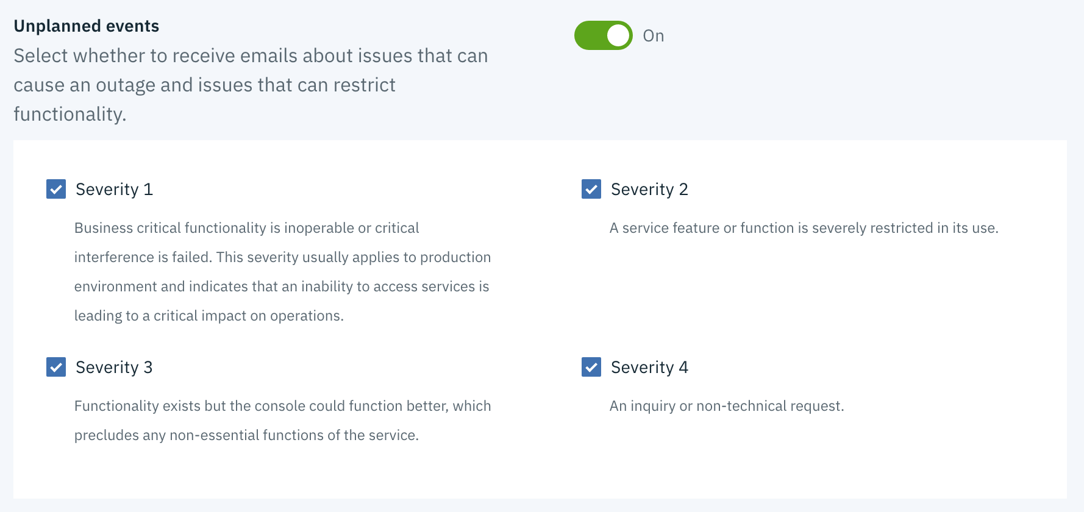
Check your email preferences
https://cloud.ibm.com/user/notifications

Slide 40
8. Contact to Customer Support

Slide 41
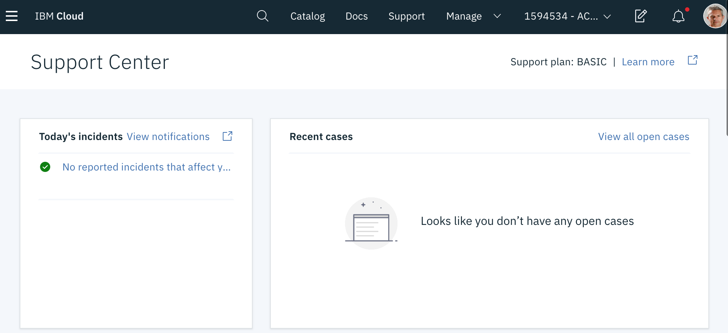
Support Case
1
2
https://cloud.ibm.com/unifiedsupport/supportcenter

Slide 42
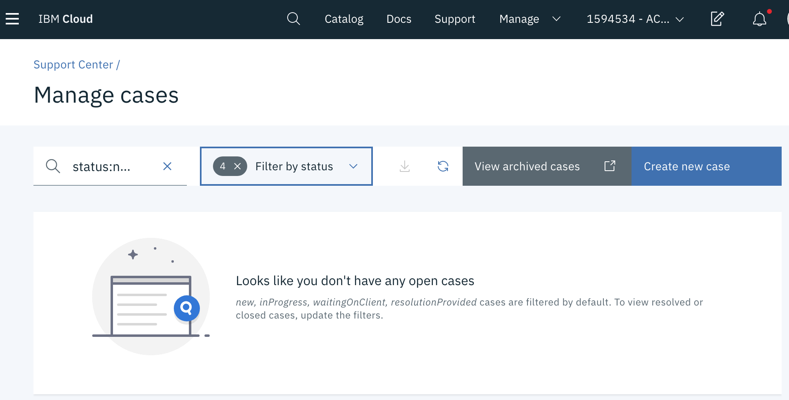
Create a New Case
1

Slide 43
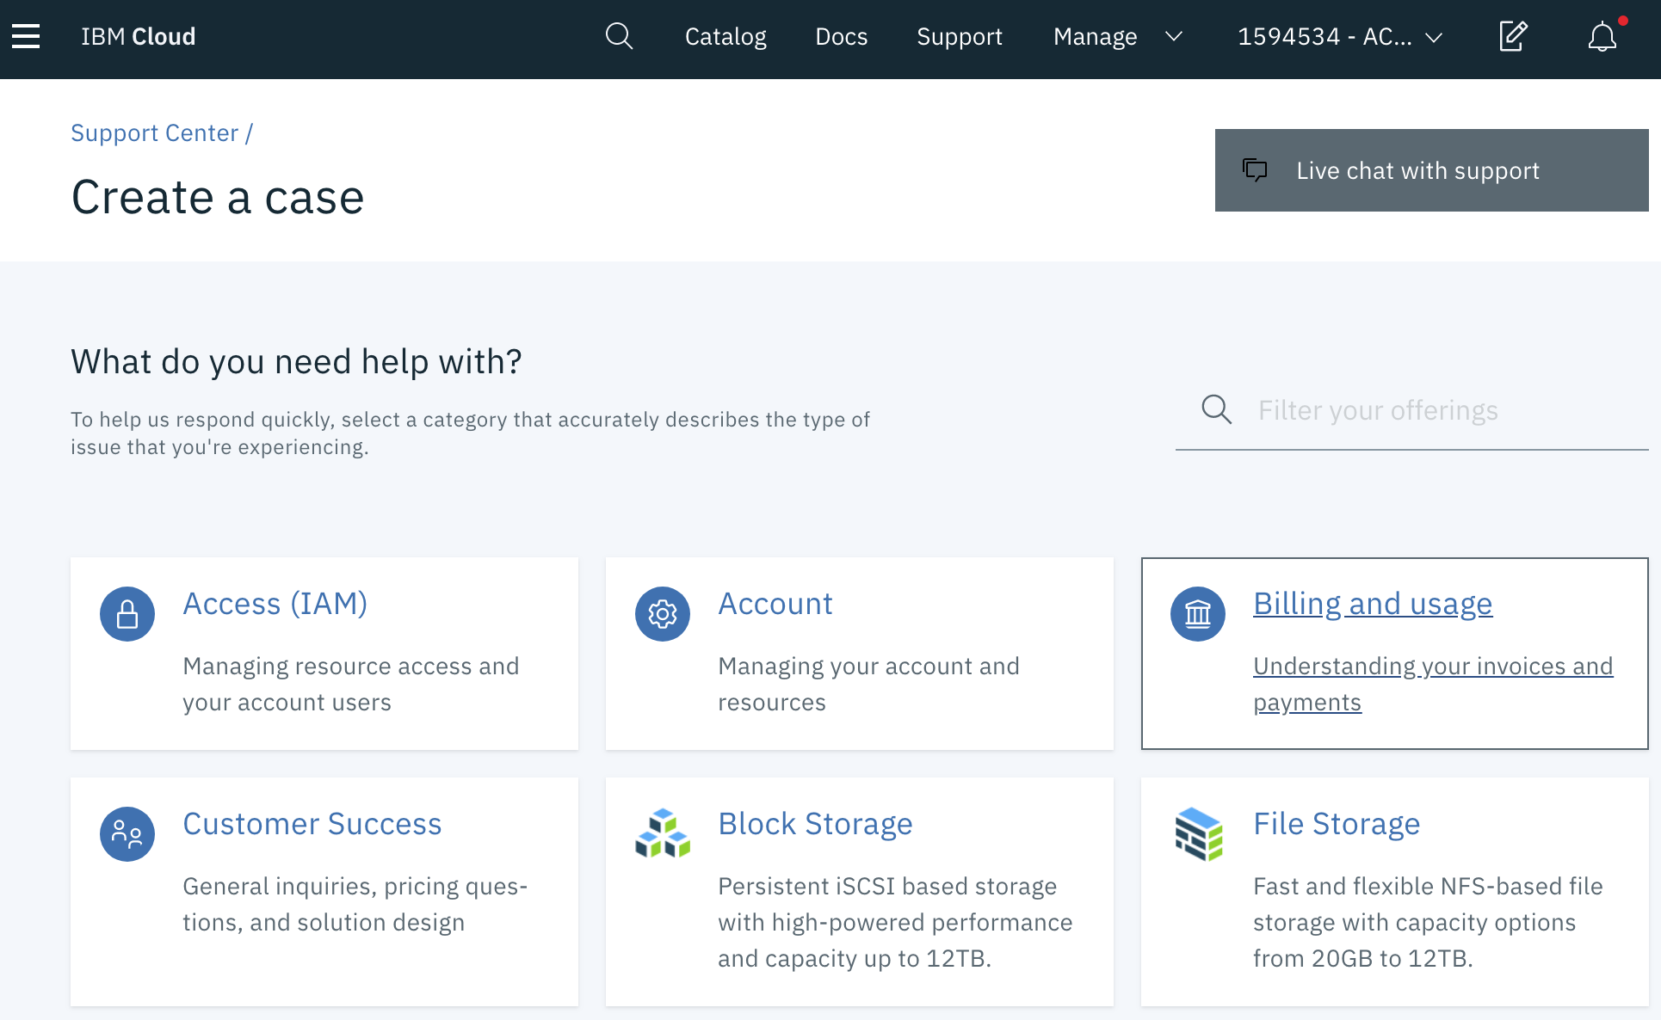
Select the type of case

Slide 44
9. Enable VRF Virtual Routing and Forwarding (VRF)

Slide 45
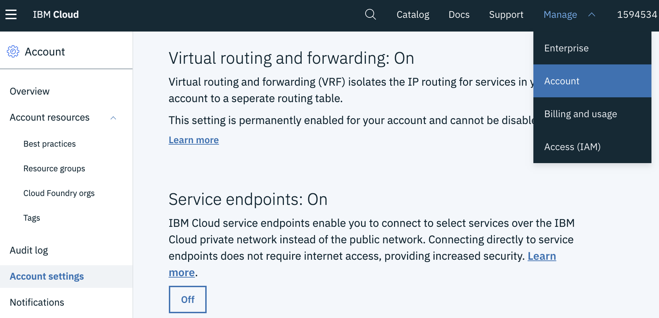
Make sure VRF is turned on to user private Service Endpoint
3
1
4
2
https://cloud.ibm.com/account/settings

Slide 46
10. Connect with IBM Cloud CLI Command Line

Slide 47
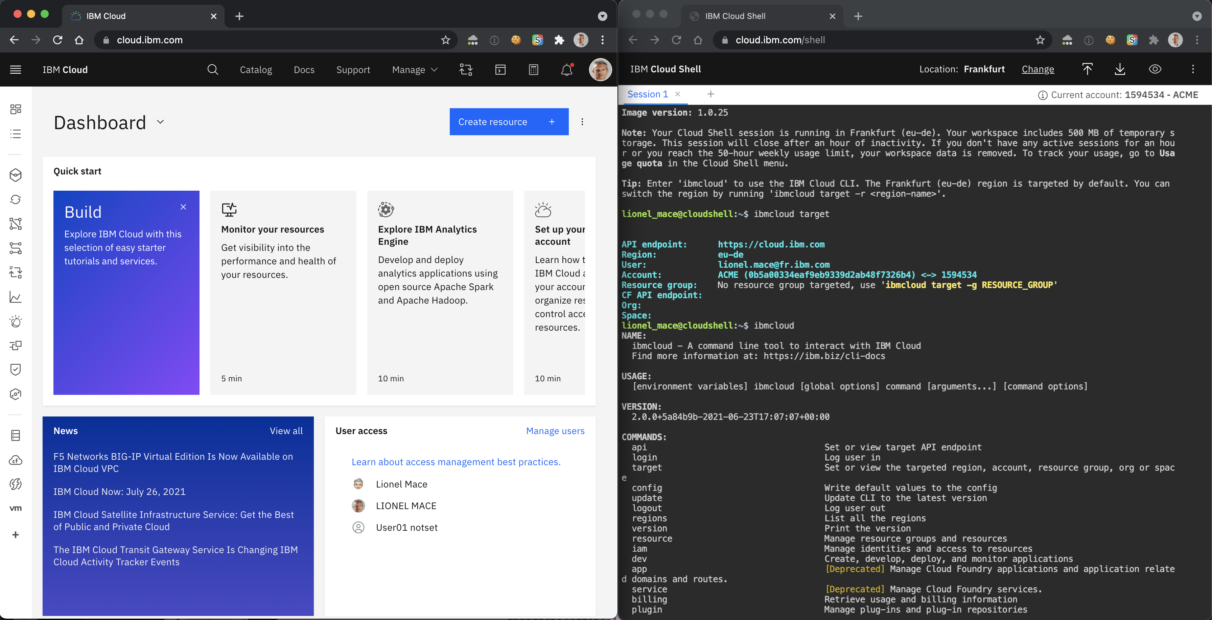
Use the hosted Cloud Shell
https://cloud.ibm.com/shell

Slide 48
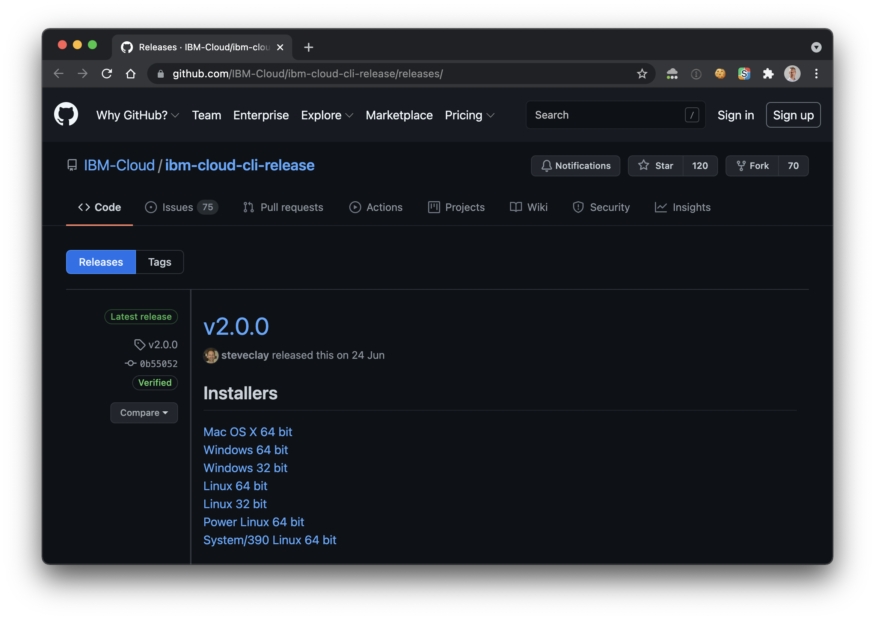
Install the IBM Cloud CLI
https://github.com/IBM-Cloud/ibm-cloud-cli-release/releases/

Slide 49



Main Command
Lines
ibmcloud login
IBM Cloud Account
ibmcloud target –r eu-de
Region
CONTAINER REGISTRY (CR)
Namespace
ibmcloud cr images
docker push <my-image>
ibmcloud target –g <rg-name>
RESOURCE GROUP (RG)
ibmcloud ks
Kubernetes
Service (KS)
Cluster
Logging and Monitoring data
kubectl
Namespace
DOCKER
REGISTRY
ibmcloud resource
CLOUDANT
Developer
ibmcloud target –o org –s space
Cloud Foundry (CF) Organization
Cloud Foundry Space
ibmcloud cf
APPS

Slide 50

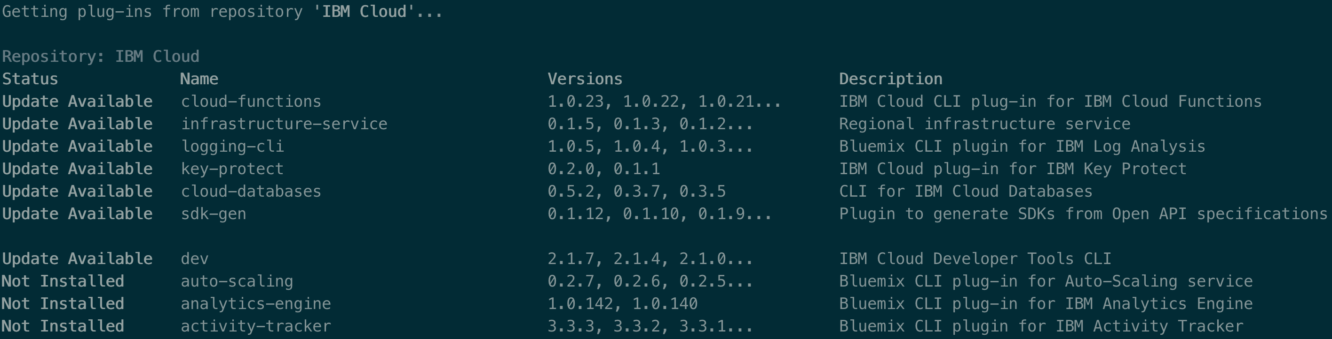
Command Line CLI Plugins
ibmcloud plugin repo-plugins -r "IBM Cloud"
Developer

Slide 51
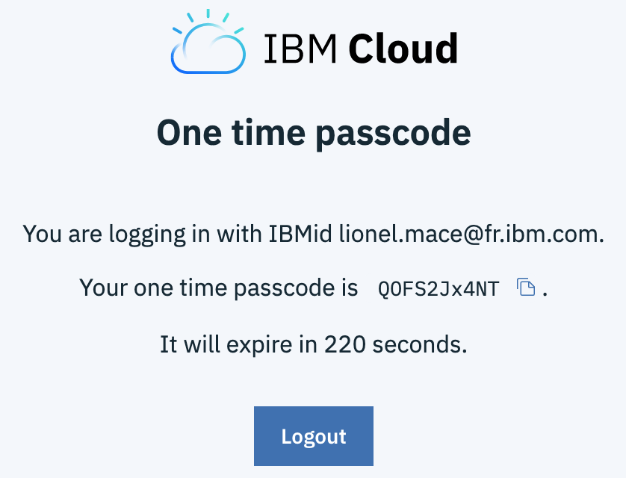
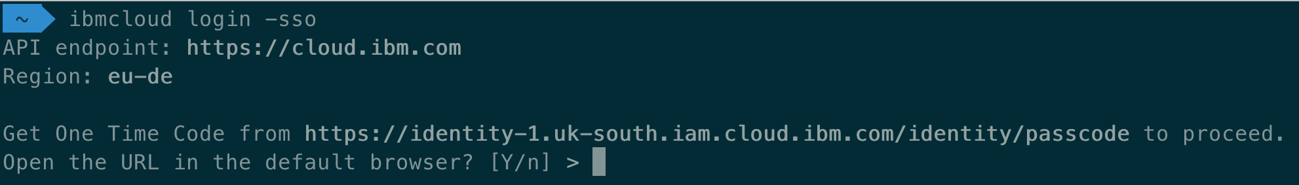
Login in to IBM Cloud CLI with a Federated ID
Get a one-time passcode by specifying the SSO parameter: ibmcloud login -sso
Follow the specified URL to get the passcode. https://iam.cloud.ibm.com/identity/passcode. In the browser, log in with with your federated id.
Copy and paste the passcode value as your input

Slide 52
11. Create Enterprise Account

Slide 53
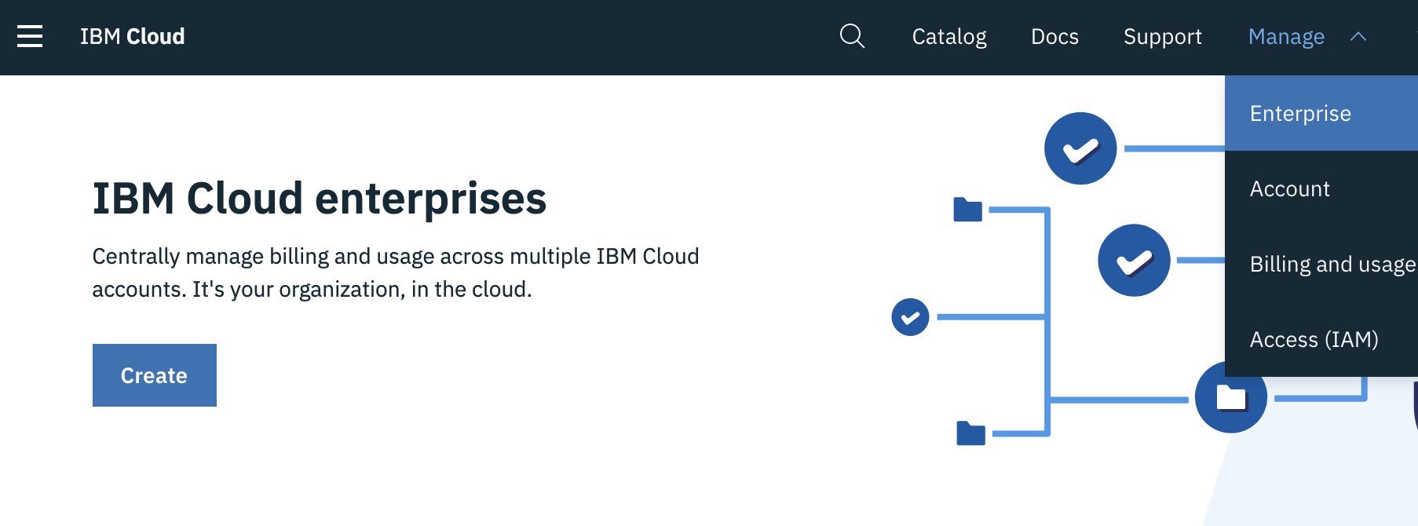
Enterprise Account
1
2

Slide 54
Enterprise Account
Enterprise Account
Account Group
Account
Account Group
Account Group
Account
Account
Account
Support complex Enterprise Hierarchy
Consolidated Billing
Nested Account Groups
Create New Account or Import Existing Account
Available in the Console or by API
Notes:
maximum depth is 5, max # of accounts is 300, and max # of account groups is 100

Slide 55
12. Enable SSL VPN Access

Slide 56
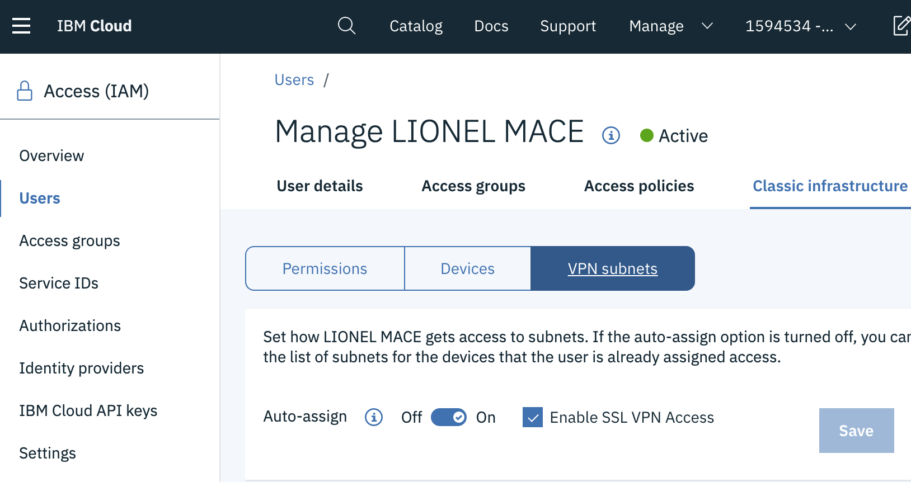
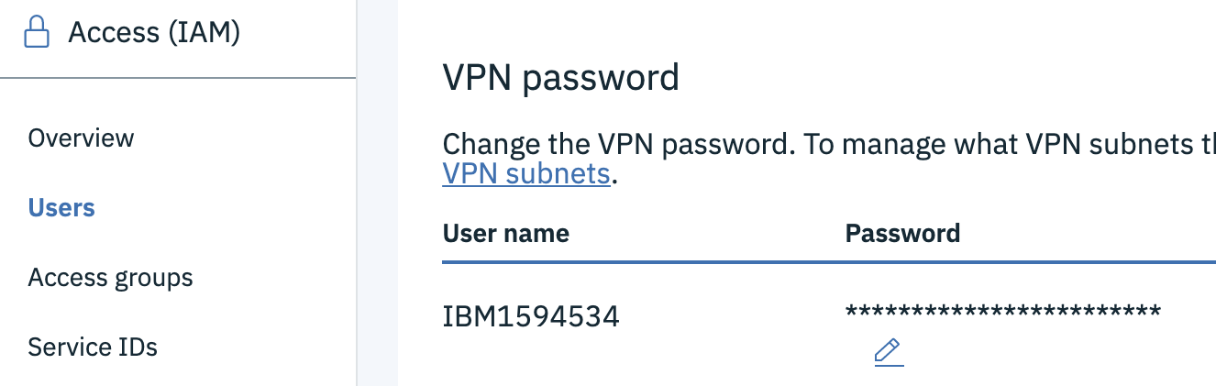
Retrieve your VPN Credentials
Select a User
Make sure « Enable SSL VPN Access » is turned on.
Scroll down to VPN password
1
3
2
http://cloud.ibm.com/users

Slide 57

Enable VPN Access
Step #1 – Select the Data Center VPN Portal
https://www.softlayer.com/VPN-Access
Ex: https://vpn.fra02.softlayer.com/ for Frankfurt
Step #2 - Install Client VPN MotionPro Plus
https://apps.apple.com/us/app/motionpro-plus/id1218085720?mt=12
Step #3 - Configure new gateway
Set the correct gateway: vpn.fra02.softlayer.com
Set the VPN User and Password

